Slide 1
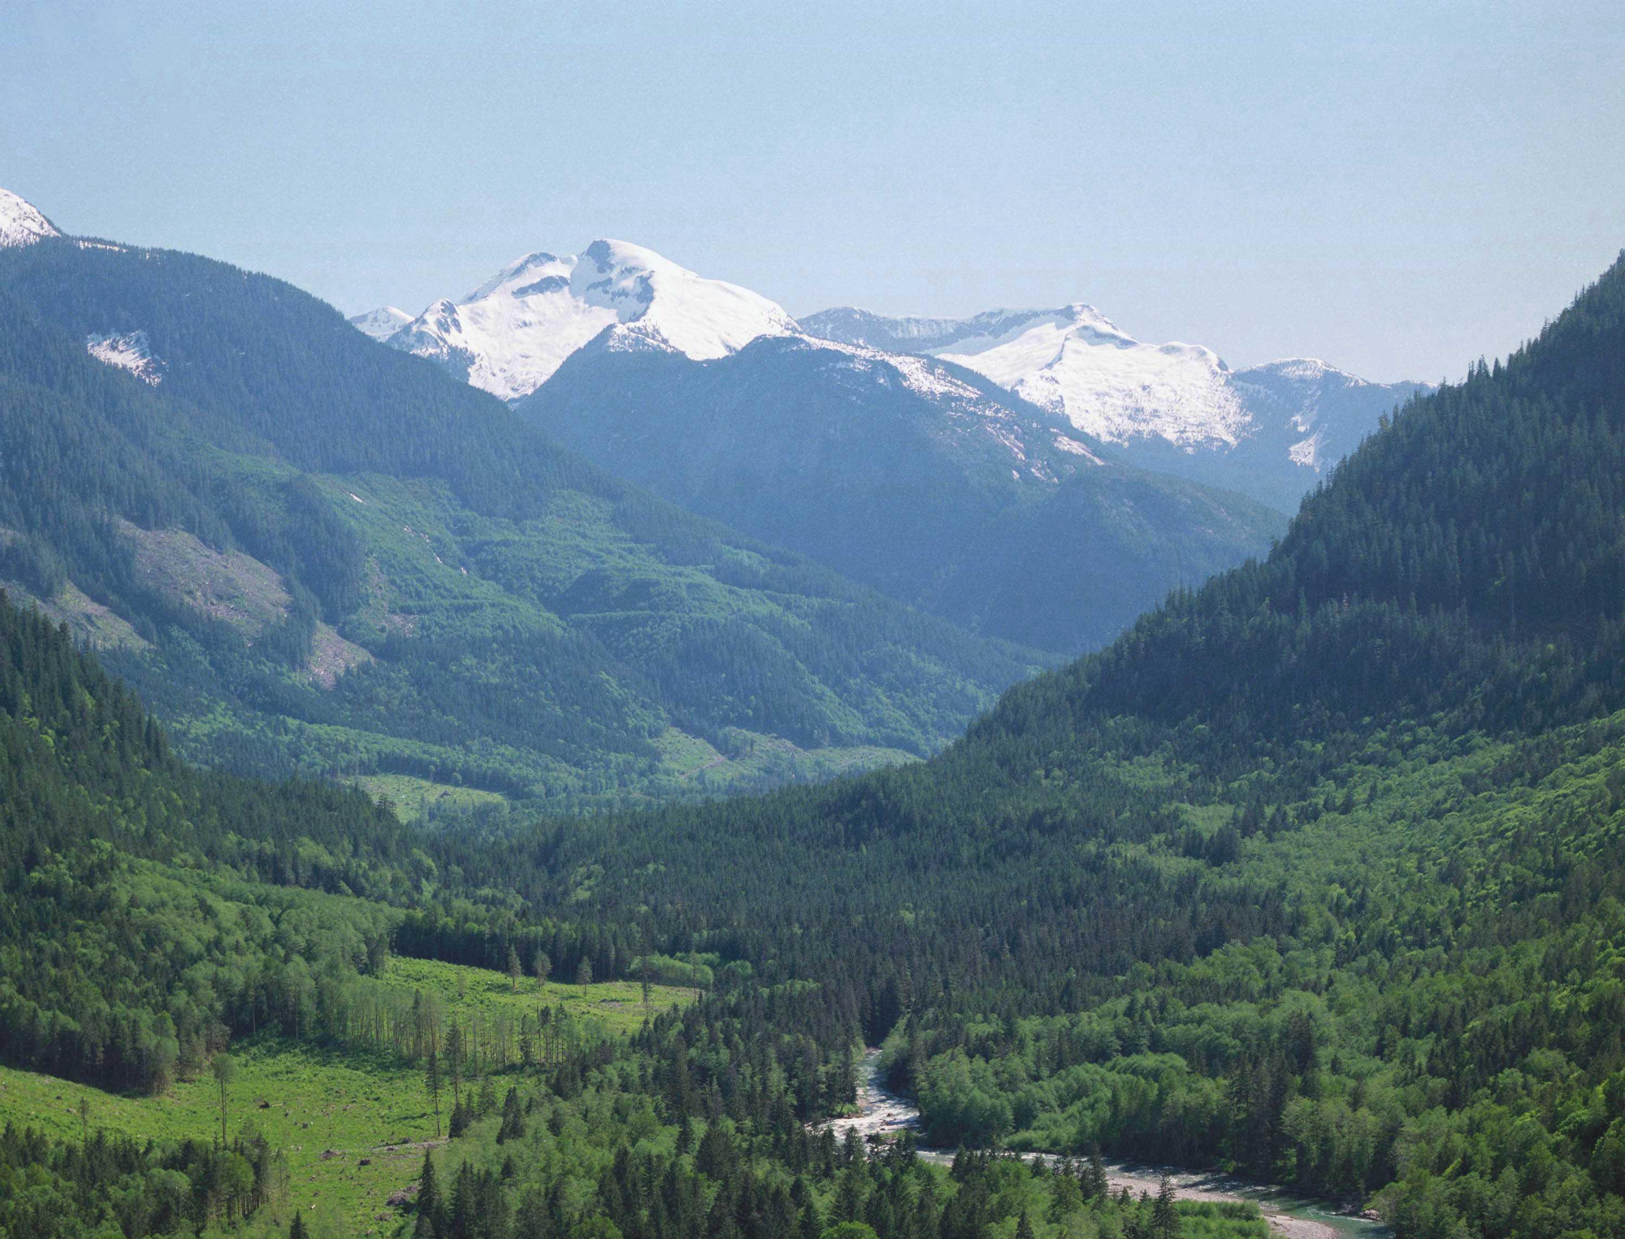

Managing for Visual Quality
under Forest & Range Practices Act
BCTS Seaward – tlasta
Port McNeill
June 26, 2013
Presented by:
Lloyd Davies, RPF
Visual Resource Management Specialist
Coast Forest Region
Ministry of Forests, Lands & Natural Resource Operations

Slide 2
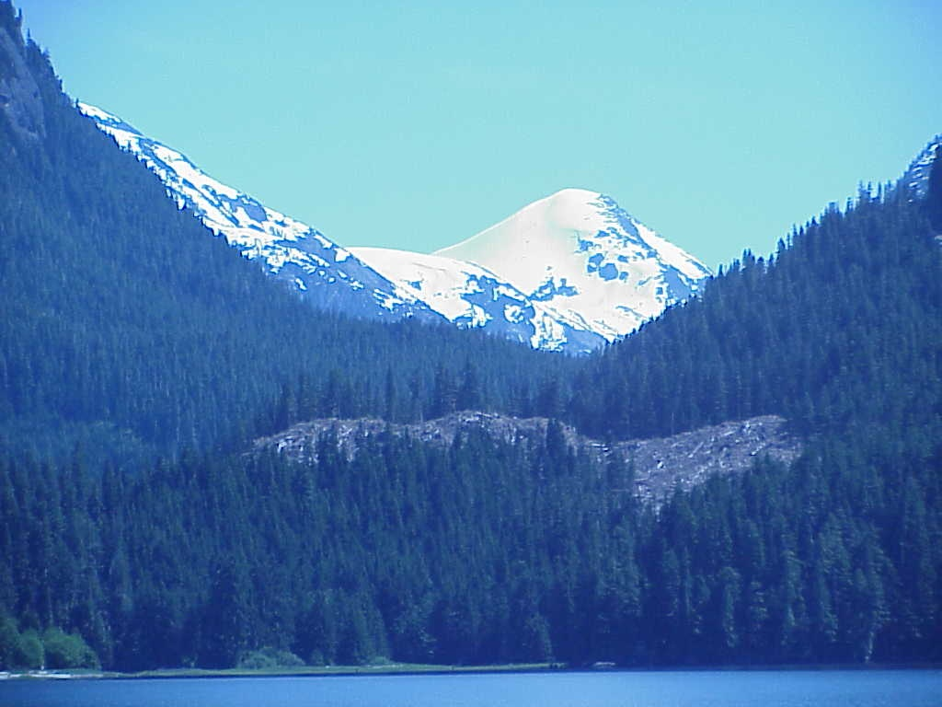
Topics
Terminology/Coast Forest Area
Why we manage for Visual Quality in BC?
How do we manage Visual Quality in BC?
  public perception
  visual inventory
  FRPA scenic areas, Visual Quality Objectives
  visual design
  visual impact assessment
Forest Stewardship Plans.
Compliance & Enforcement examples.
FREP VQO Effectiveness Evaluation.
Afternoon: 1. visual impact assessments
2. Review & discuss current BCTS harvest plans

Slide 3
Workshop Objectives:
To gain an appreciation of how visual resources are managed in BC under Forest & Range Practices Act.
Become familiar with visual inventory principles, visual quality objectives, FREP monitoring, and VQO C&E.
Gain an understanding of when, where and how to complete pre-harvest visual impact assessments.

Slide 4
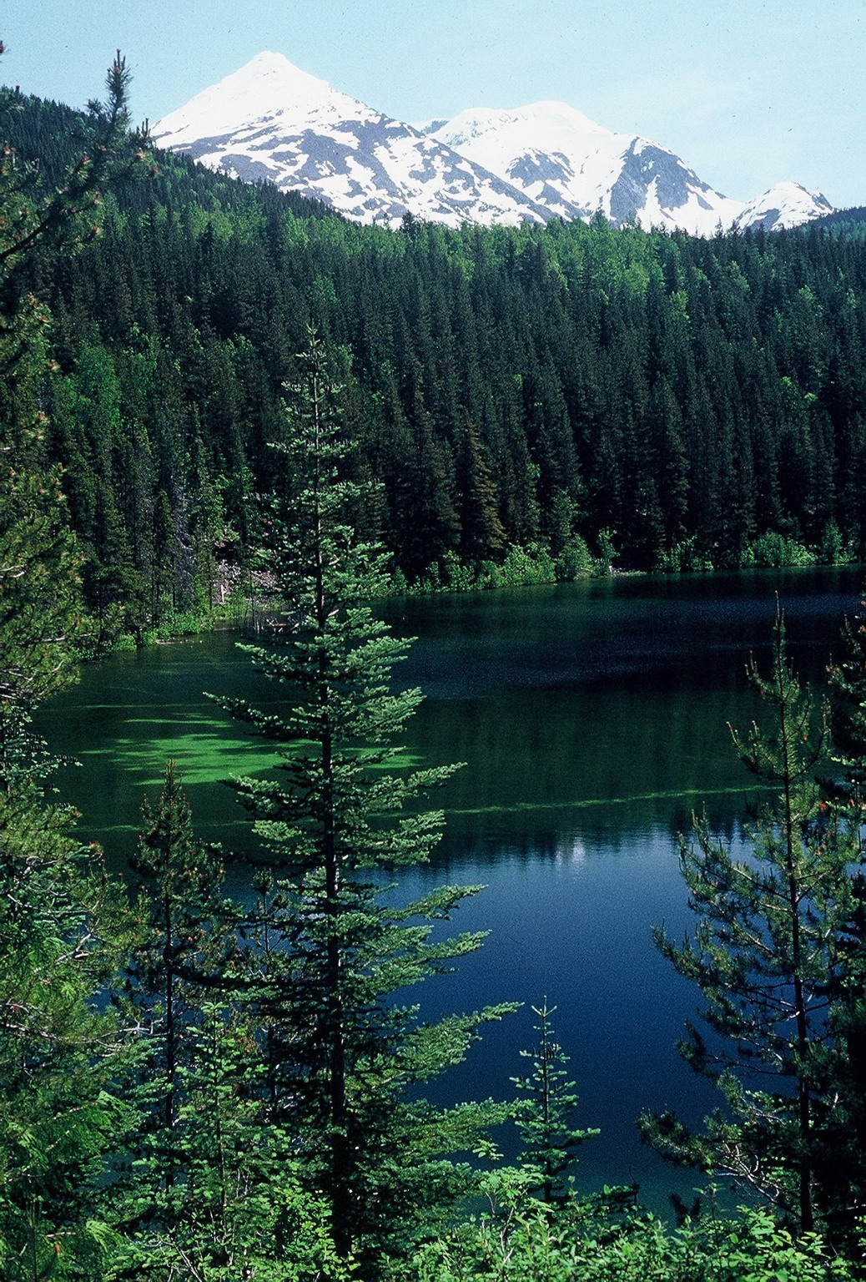
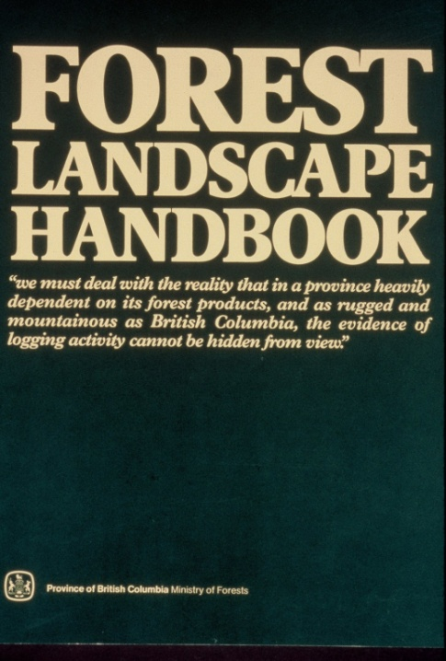

terminology
forest landscape management
scenic beauty management
forest aesthetics
visual resource management
The Ministry of Forests started managing visuals in early 1980’s with the publication of the
Forest Landscape Handbook in 1981.

Slide 5
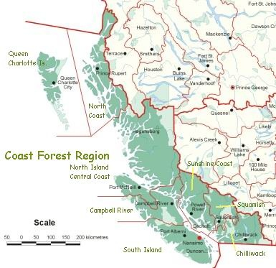
Coast Forest Area

Slide 6
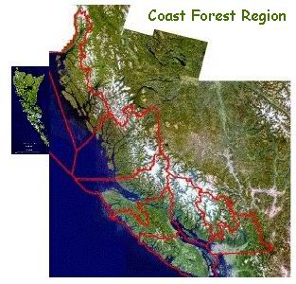
165,000 km2
20% larger than NB, NS, PEI
Approximate size of Washington State

Slide 7
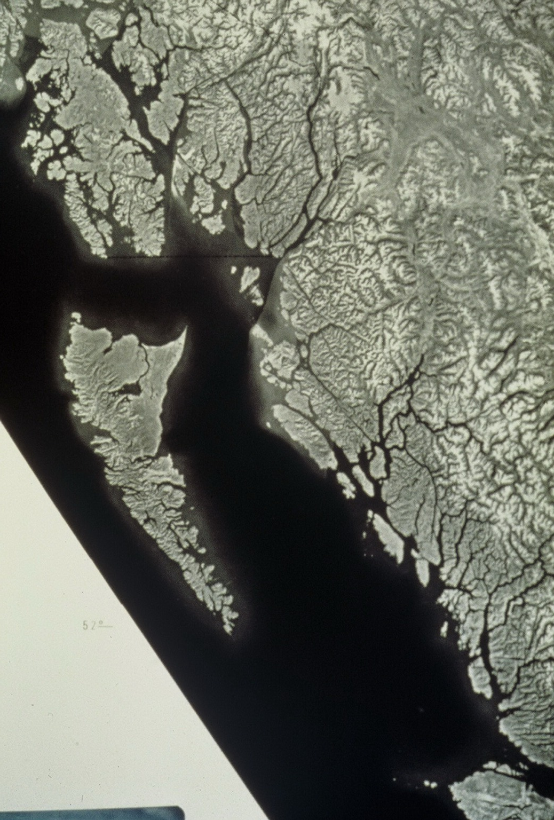

Coastal BC
Spectacular variety and diversity
Coastal rainforest, fiords, mountains
Dramatic land-water interfaces
Domestic and international tourism
majority of BC population
Result .... Lots of visual issues!

Slide 8

Why do we Manage for Visual Quality in BC?
Scenic landscapes are highly valued by BC residents.
Unaltered forest landscapes are preferred.
Scenic landscapes provide BC’s Tourism Industry with a competitive edge.
Well designed landscapes provide the public with confidence that our forests are being managed carefully and sustainably.
Approved HLP’s have made commitments regarding Visual Resources.
Visual Quality is one of 11 core values managed and protected under Forest and Range Practices Act (FRPA).

Slide 9
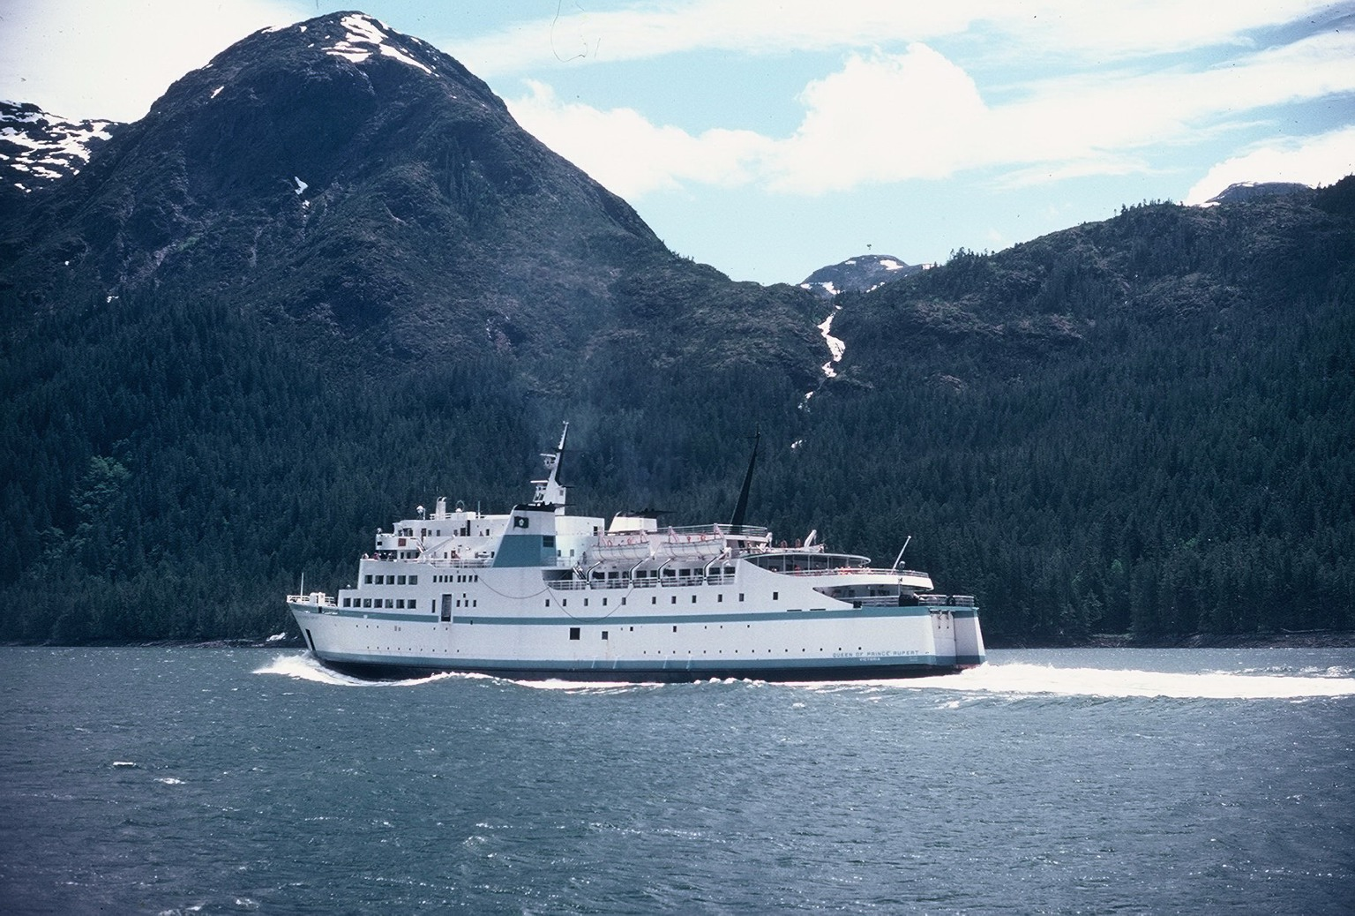
Super Natural BC …
Residents and tourism expectations for scenic quality

Slide 10
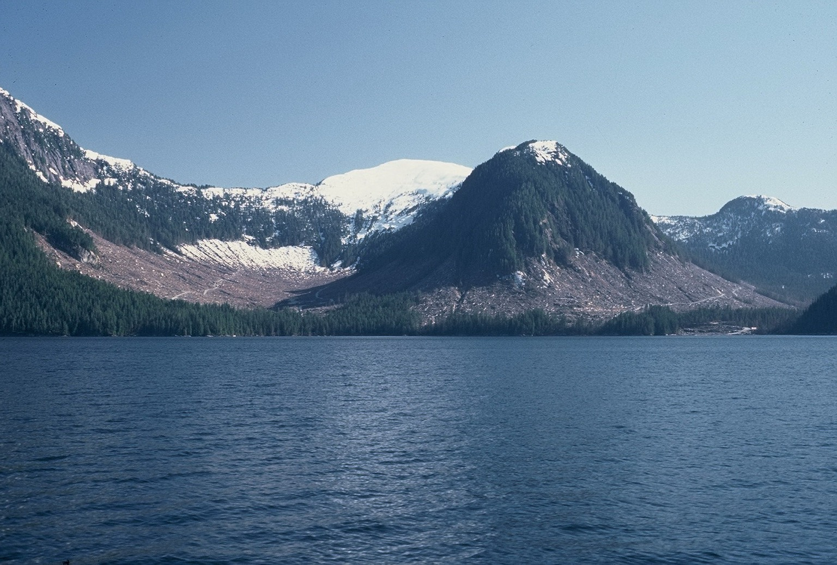
Inside Passage, BC Ferries/cruiseship travel route
High visual impact of coastal clear cutting
Unmatched viewer expectations
International boycotts of BC forest products

Slide 11


New BC Logo
… our mountainous and coastal landscapes are a proud feature of this province, promoted, recognized around the world, and help shape who we are as British Columbian’s.

Slide 12
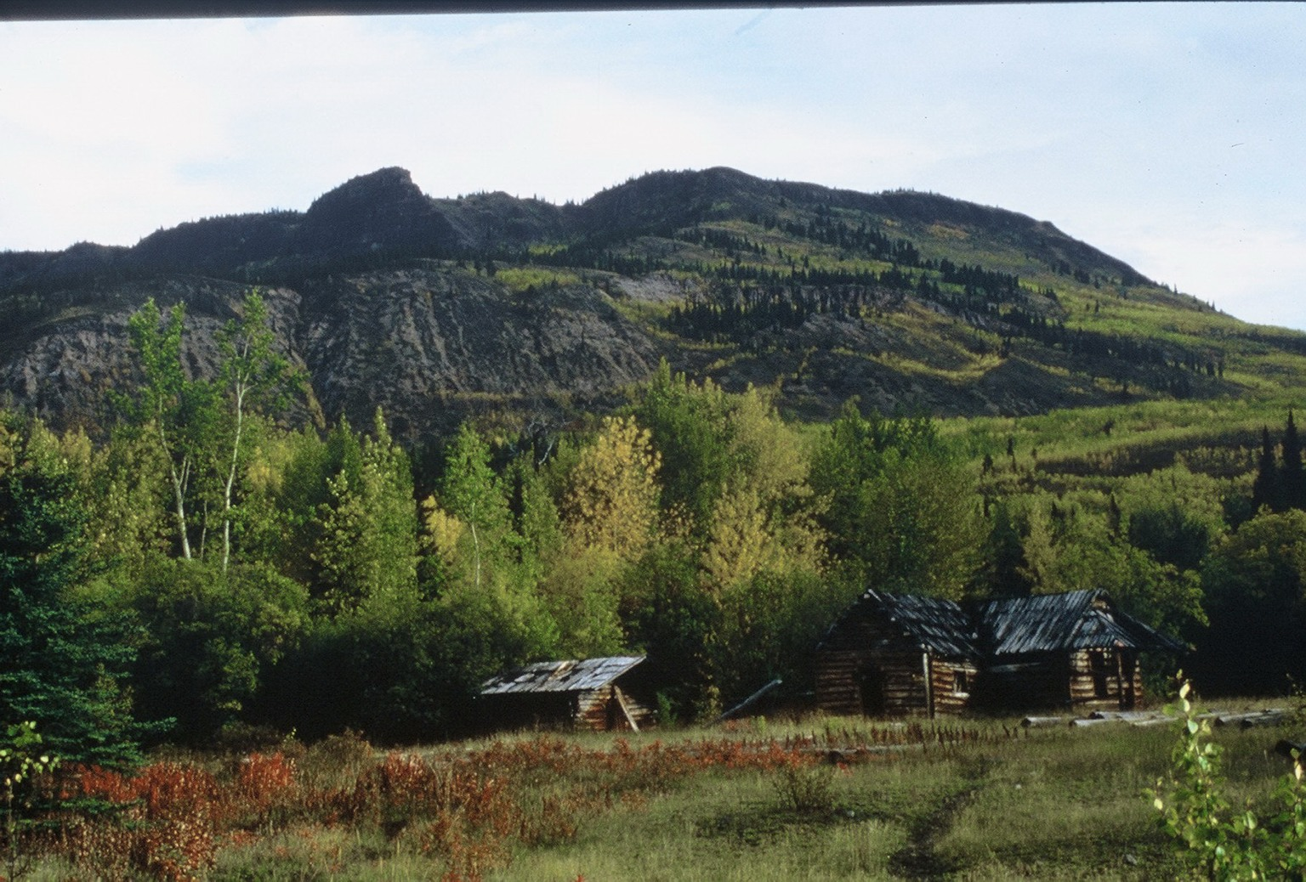
Perceptions … “beauty is in the eye of the beholder”

Slide 13
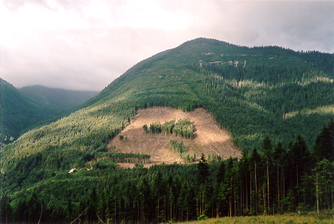
Visual Resource Management
Is about this
Forestry activities that fit the landscape.
34 ha
Not this!
Forestry activities that are out of character with the landscape .
29 Ha

Slide 14
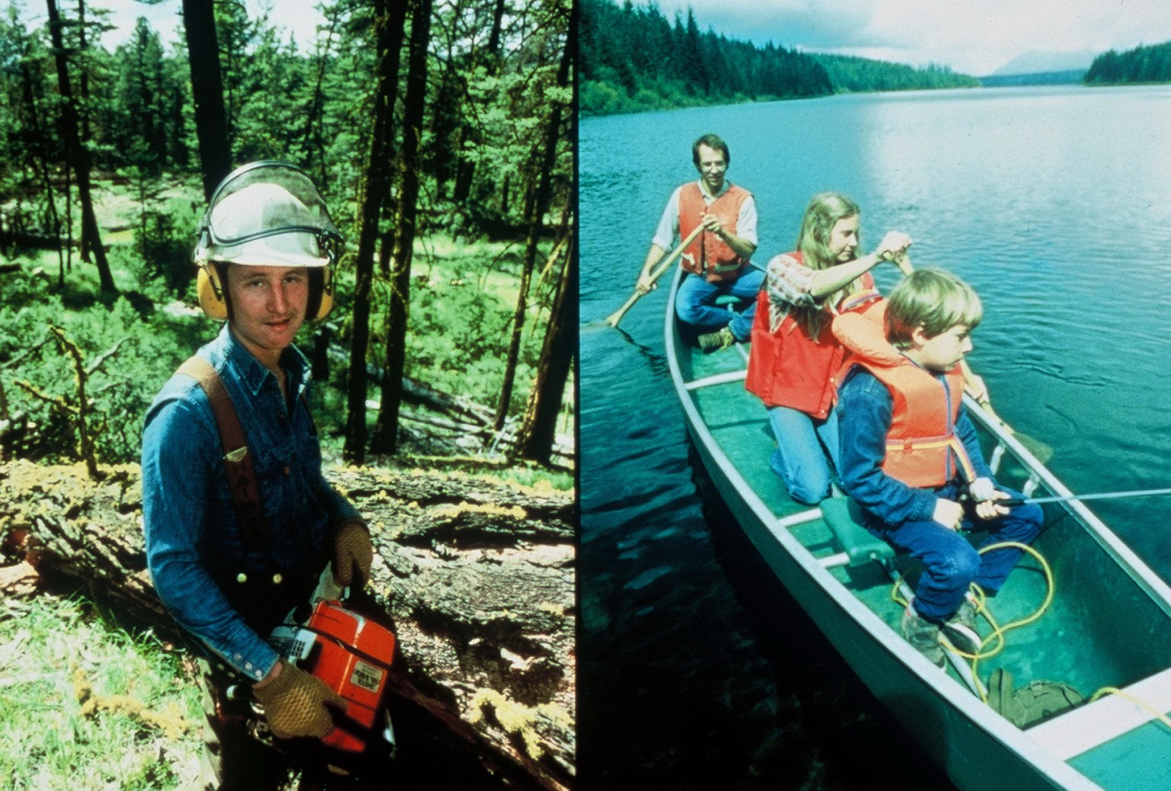
Its not always either/or … but integrating and managing for both
wood production and recreation/scenic values.

Slide 15
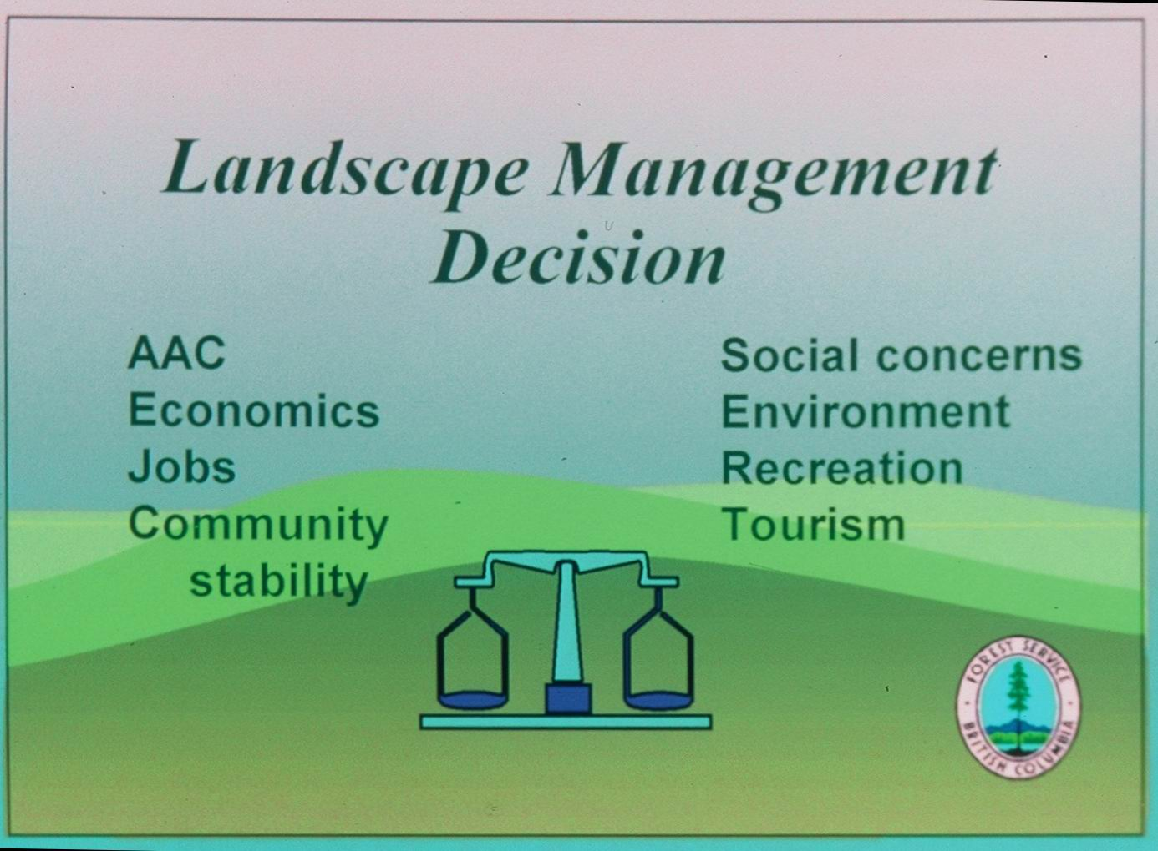

Slide 16
How do we Manage for Visual Quality in BC?
Conduct research to determine Public Preferences.
Carryout Visual Landscape Inventory to identify the visible landscape and rate its sensitivity to human made alteration.
Designate important visible landscapes as Scenic Areas
Establish Visual Quality Objectives to define the level of alteration that would be acceptable on the landscape.
Approve Results/Strategies in FSP’s that will be consistent with established VQOs.
Conduct C&E inspections, to ensure that the results specified are achieved, or the strategies have been carried out.
Carry out FREP (Forest & Range Evaluation Program) VQO Effectiveness Evaluations to monitor trends in visual quality management.

Slide 17
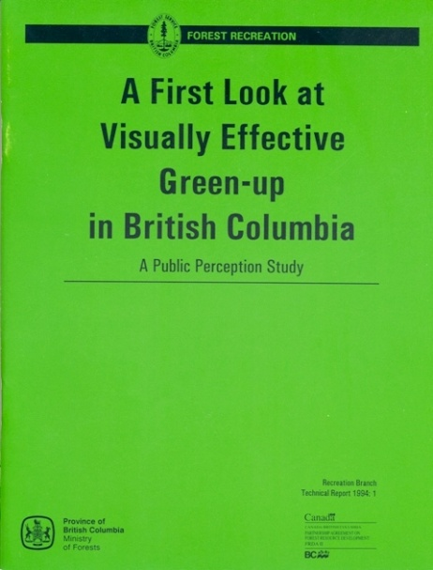
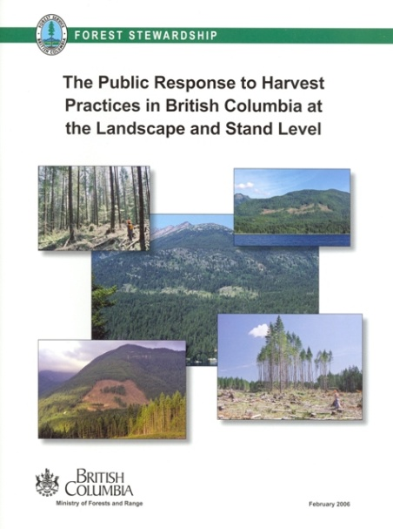
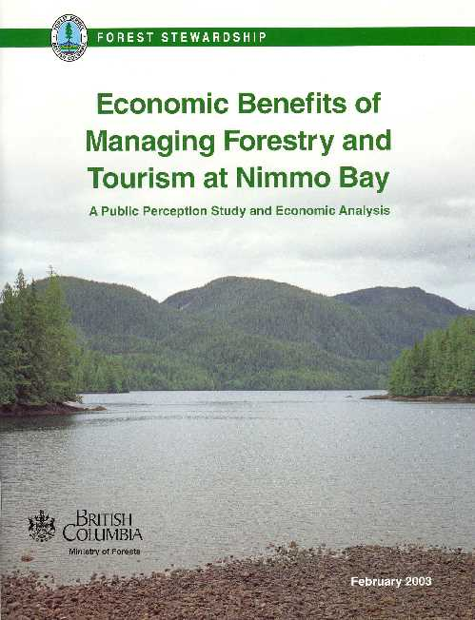
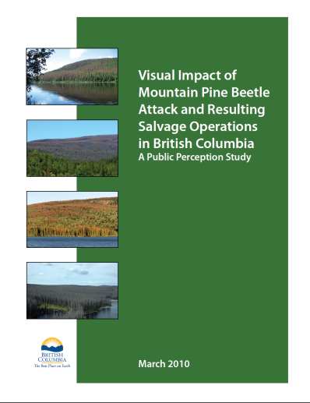
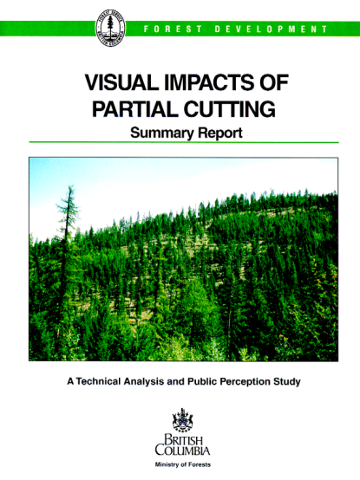
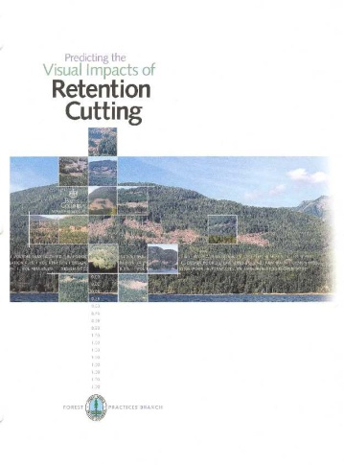
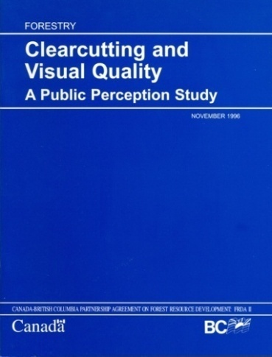
Public Perception Research
Guides Visual Resource Management
What have we learned in BC?

Slide 18
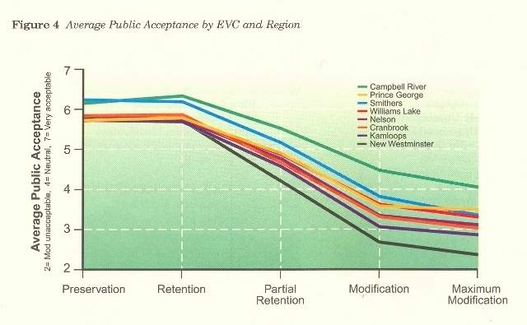
Public Response Relative to
Visual Quality Classes
The MFLNRO Visual Management System is built on the premise that the public sees things similar to Visual Experts.
Logging in Kootenay Landscapes 1989
Public Response to Harvest Practices 2006
22+ years of public perception research in BC suggests that the public almost always likes natural scenes and almost always dislikes modified scenes.
Clear Cutting to meet visual Quality 1996

Slide 19
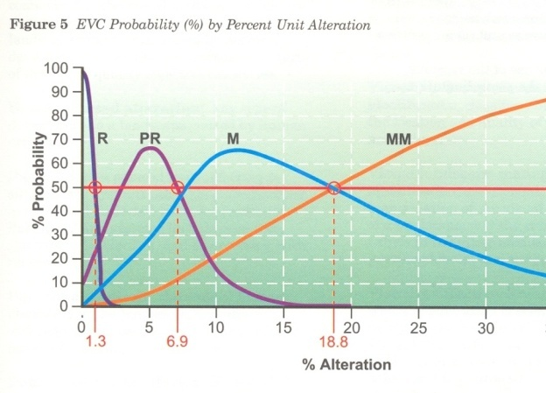
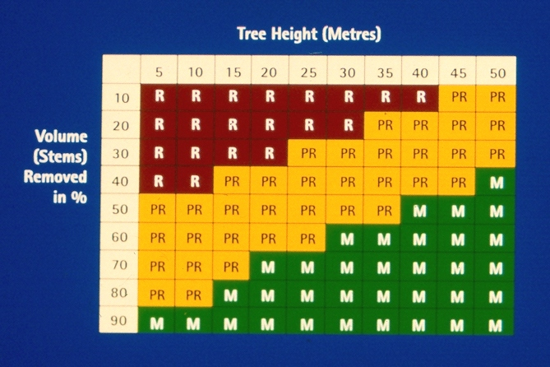
Applied Research
Much of our research is aimed at developing predictor tables.
What level of % alteration predicts a VQO?
What does the public think of different Silvicultural Systems?
How much volume/stems can be removed and achieve a VQO?
Recent Research:
Mountain Pine Beetle
Roadside foreground

Slide 20
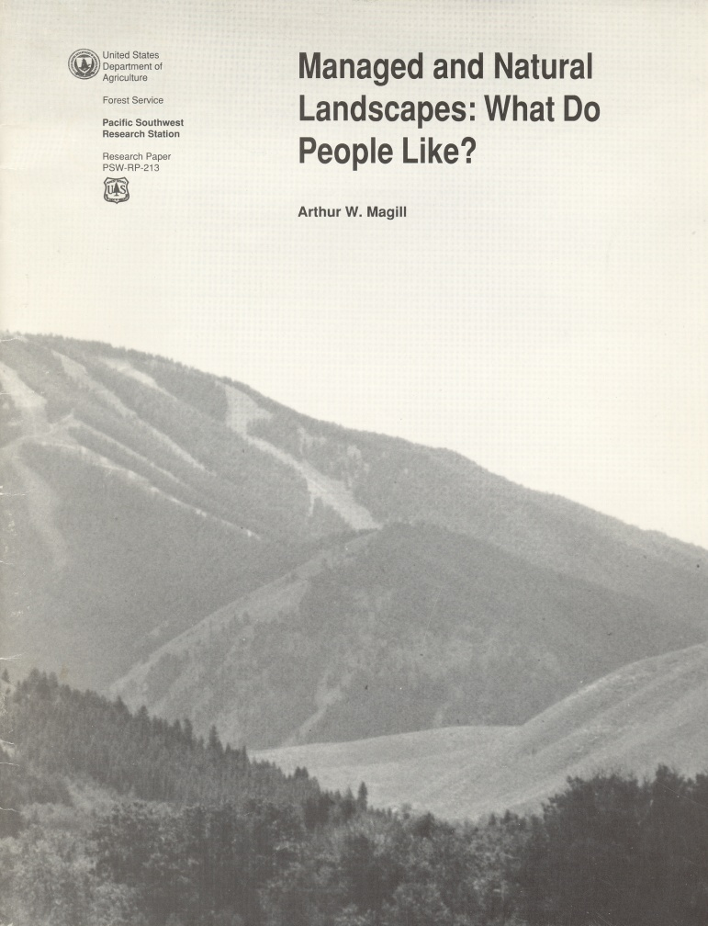

What do people like/not like?
Magill found people are attracted to natural landscape features with and without a management presence.

Slide 21
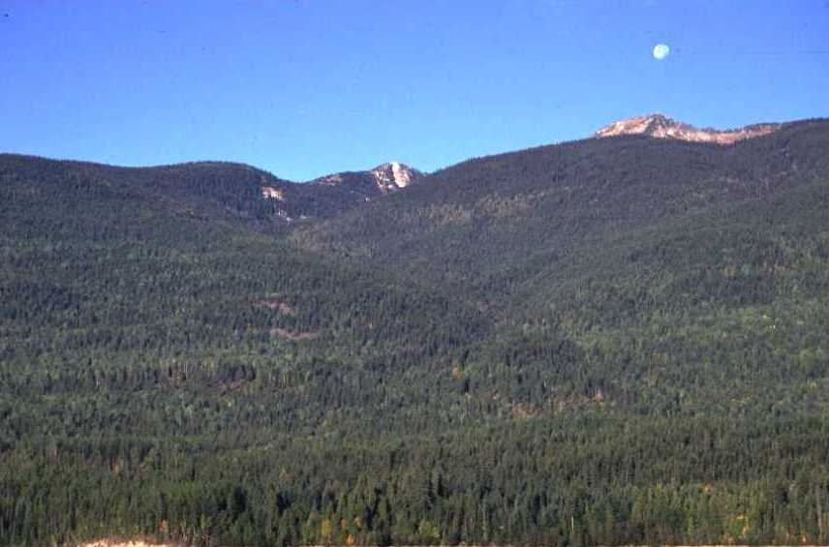
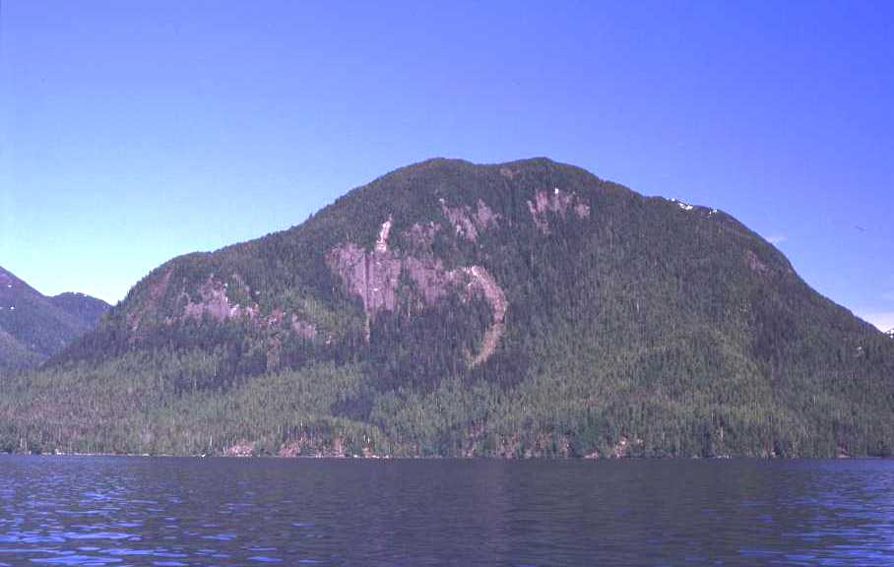
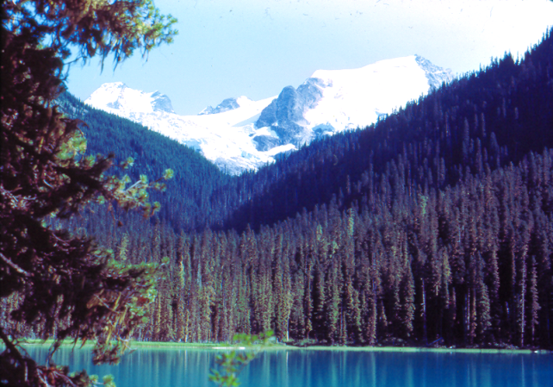
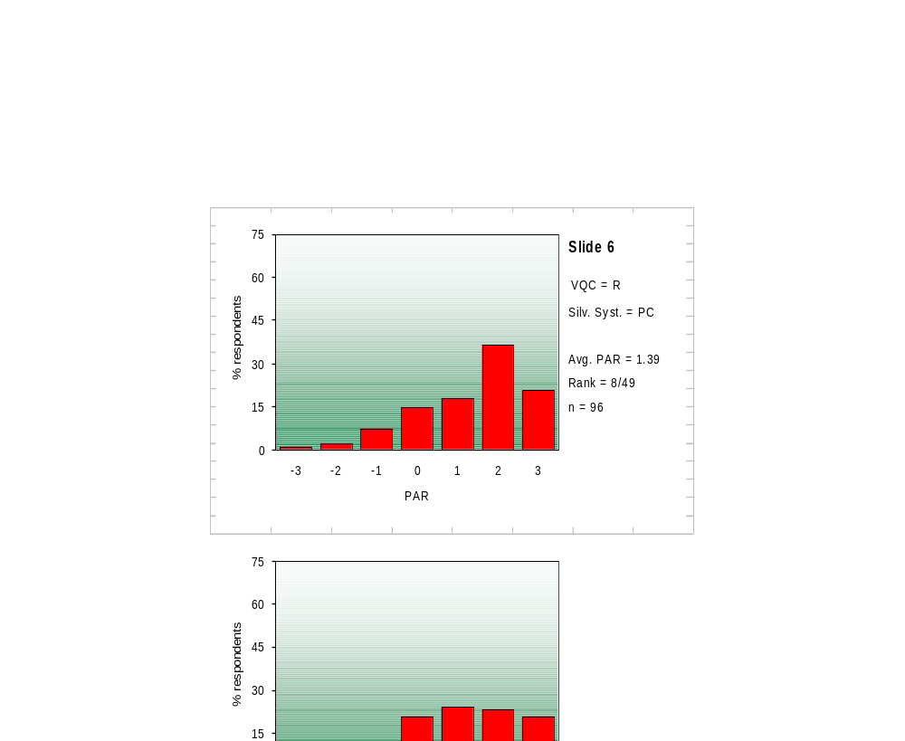
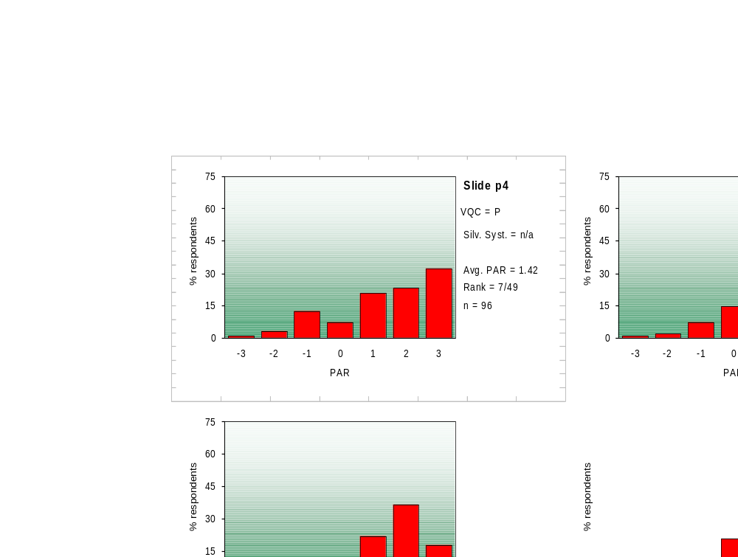
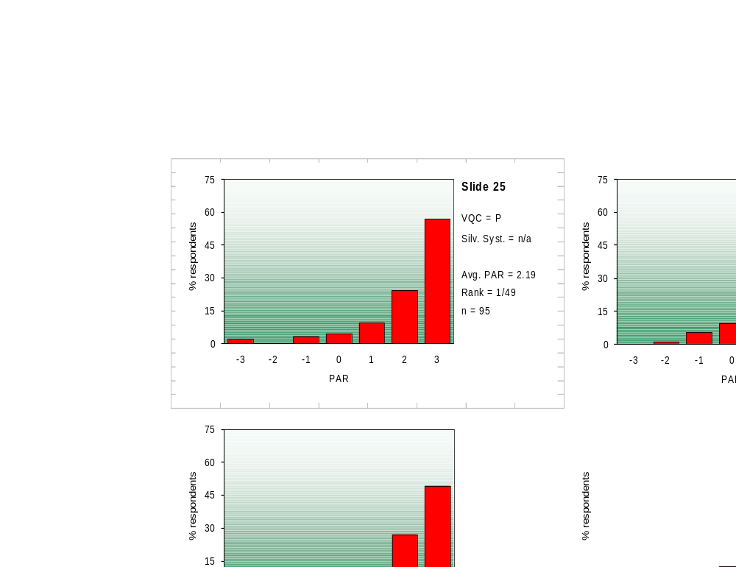
Magill and others have also found the more elements and diversity you have in a scene the better people like it.
Forest
Forest & Water
Forest, Water & Mountains
+1.39
+1.42
+2.19

Slide 22
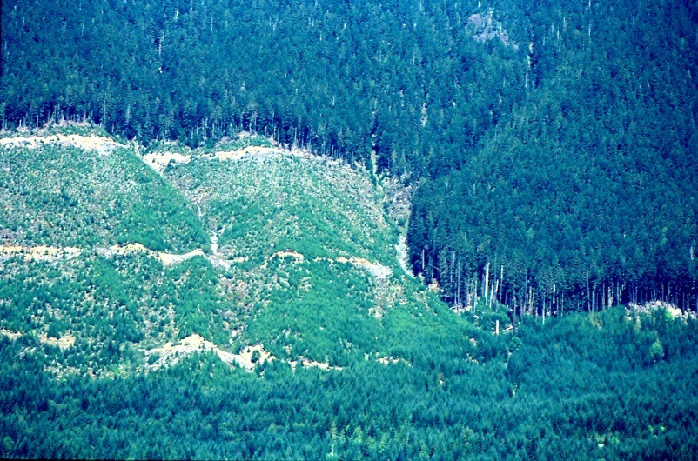
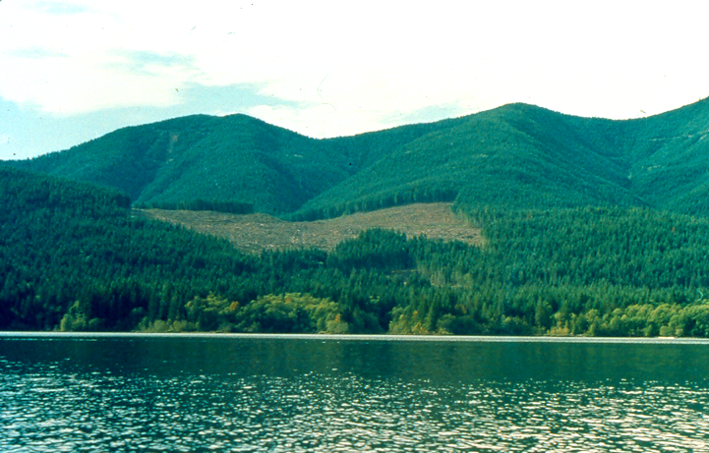
He also found:
Roads were the most frequently reported evidence of management and were disliked.
  Clear-cuts were the second management activity reported and were disliked even more than roads.

Slide 23
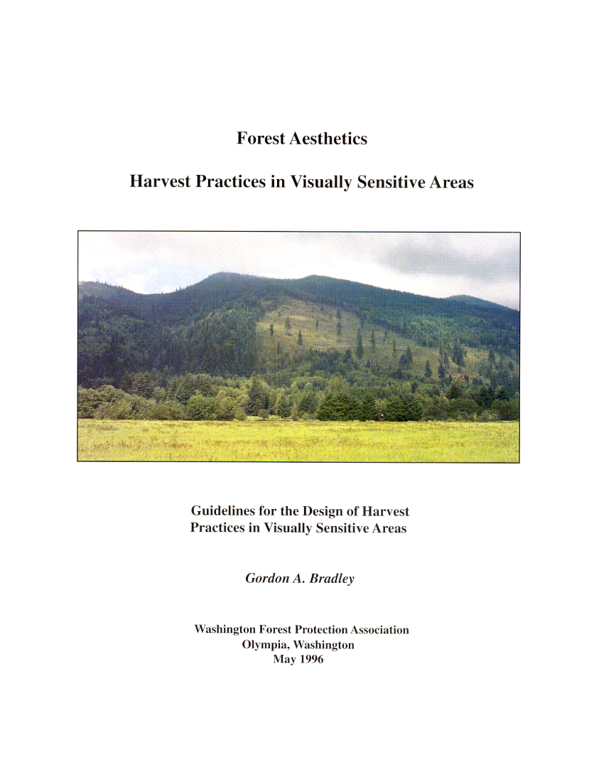
  Gordon Bradley of the
  University of Washington has
  tried to shed some light on
  why people respond negatively
  to Forest Management
  activities.
  He concluded the reason why
  people do not like what they
  see on the landscape, is
  because the activity does not fit,
  is not natural or does not appear to belong.

Slide 24
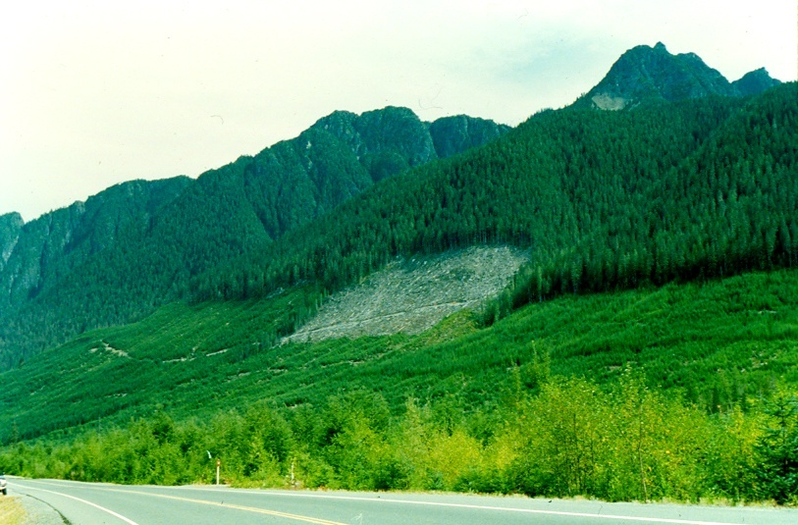
Things that people find offensive:
  Large scale openings.
Highway 19, Northern Vancouver Island

Slide 25
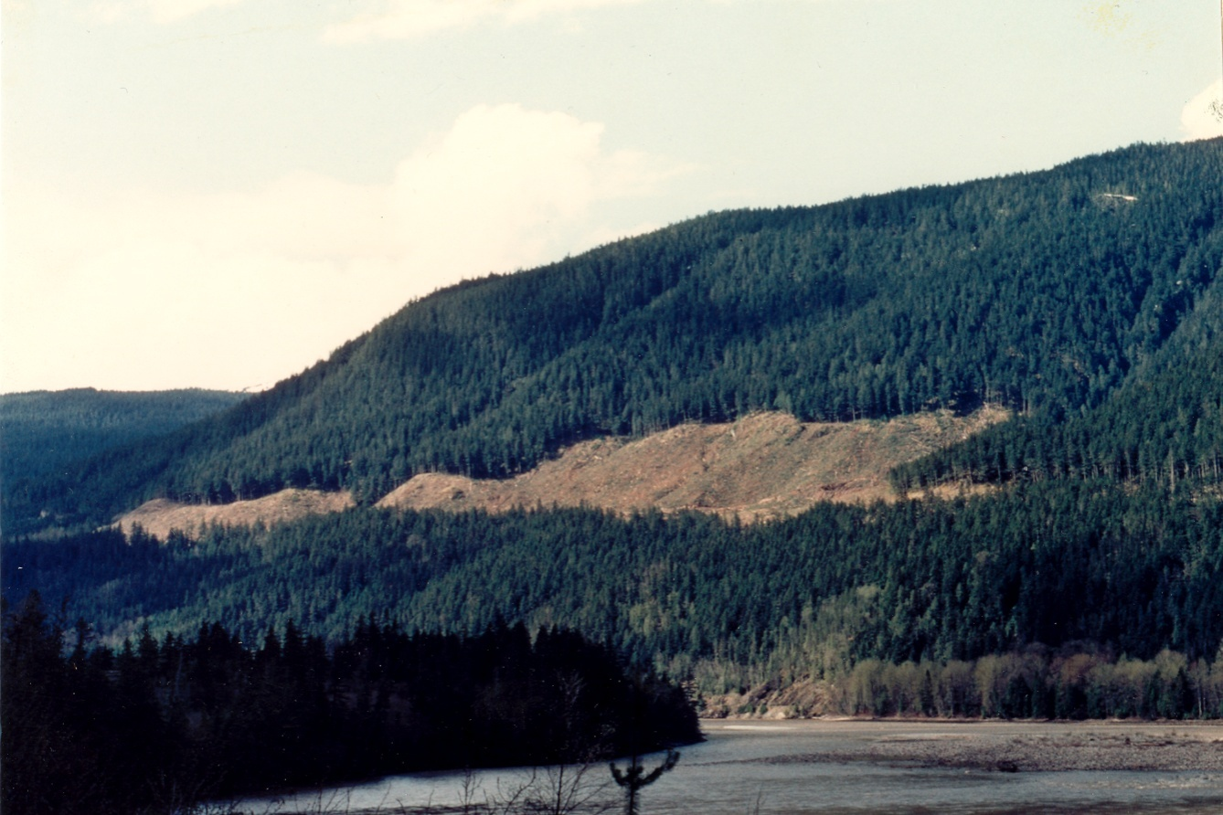

Things that people find offensive:
  Geometric shapes with vertical & horizontal lines

Slide 26
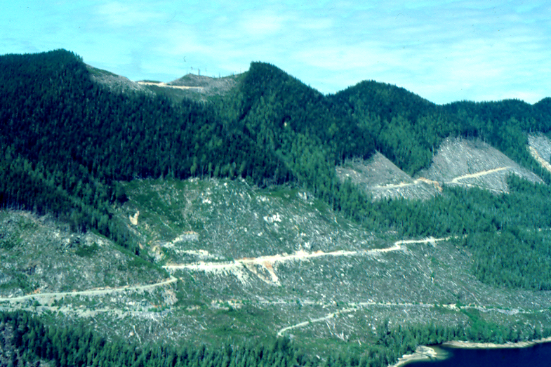

Things that people find offensive:
  Mid Slope Roads

Slide 27
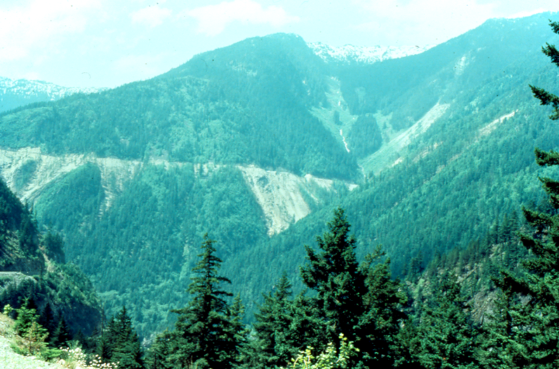
Things that people find offensive:
  Side Cast & Mass Wasting
Trans Canada Highway 1, Fraser Canyon

Slide 28
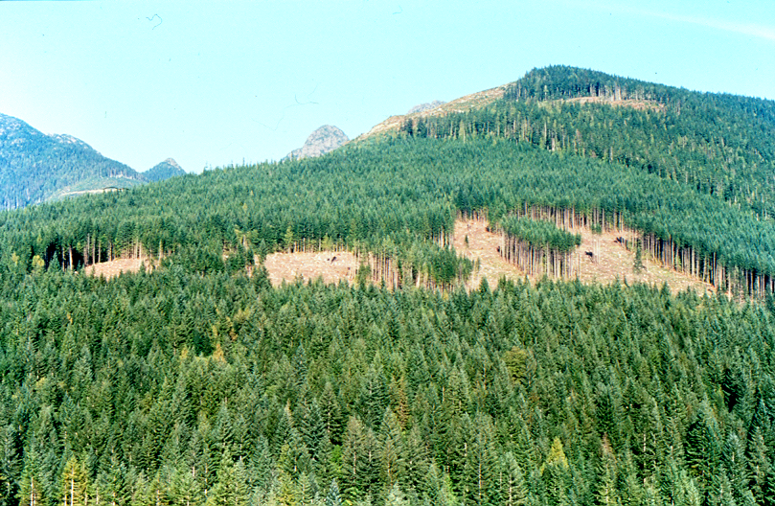
Things that people find offensive:
  Sharp Contrasts “hard edges”

Slide 29
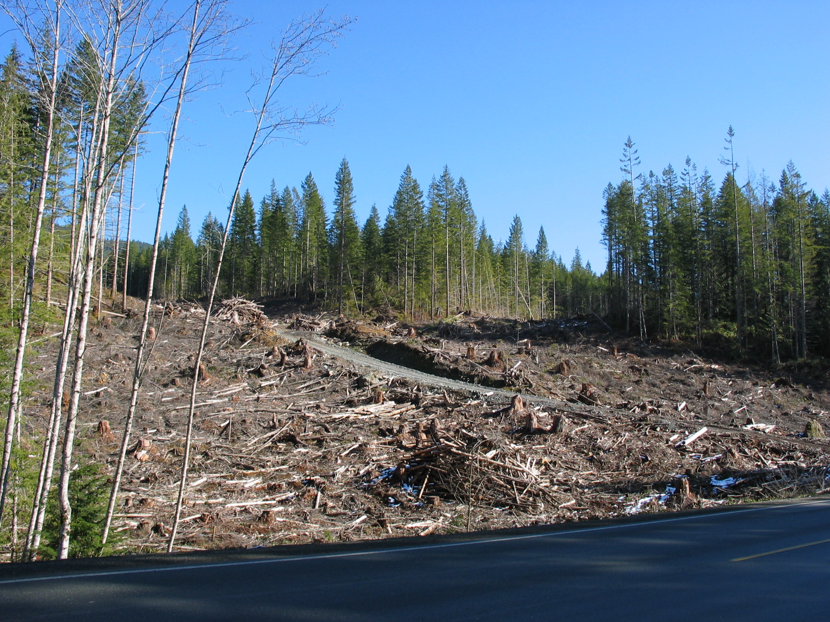
Things that people find offensive:
  Roadside Debris/logging slash
Note- Forest Practices Board audit Campbell River District (2005) critical of roadside harvesting.

Slide 30
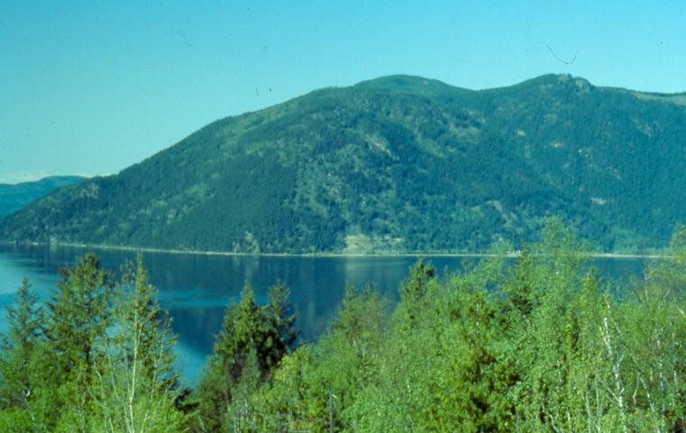
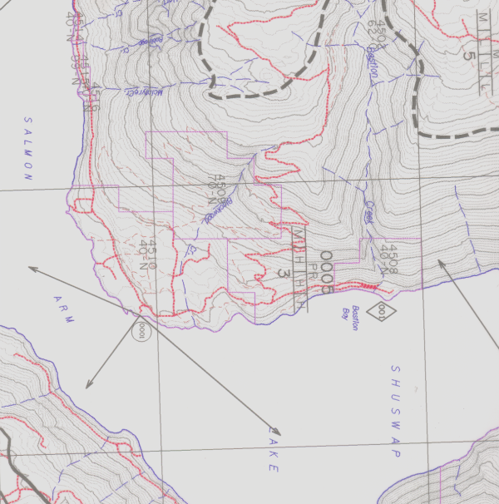
Visual Landscape Inventory - What is it?
It is the identification, classification and recording of visual values on maps.
In the case of Visuals, the visible landscape is physically mapped from specific view locations and by travelling waterways and highway corridors.
As the landscape is mapped, it is assessed using 35 factors and rated for its visual sensitivity to forest alterations. Culminates in an assigned Visual Sensitivity Class, 1-5 score.
A
A
0005
PR
M/H/H/H
3
Inventories on TSAs are done by licensees using FIA funds or by MFLNRO where required. TFL Licensees are required to maintain an Inventory of forest resources at own expense.
Government maintains VLI inventory in BC Geographic Data Warehouse.

Slide 31
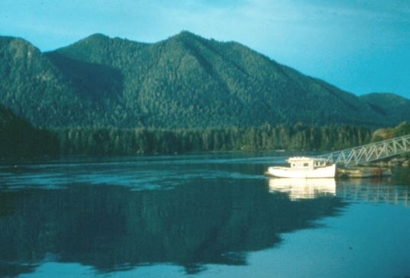

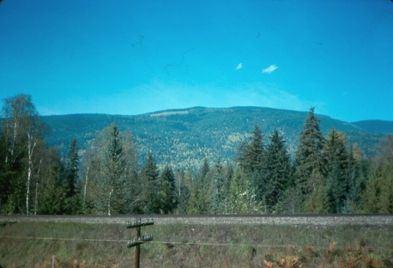
Visual Sensitivity Class (VSC)
Rates the sensitivity of the landscape to visual alteration based on the
biophysical , viewing and viewer-related characteristics.
Class 1
Very high sensitivity to alteration.
Class 3
Moderate sensitivity to alteration.
Class 5
Very low sensitivity to alteration.
Meares Island
A spectacular and very
attractive landscape.
Viewed and photographed by
thousands of people per year.
Biophysically Steep & green.
Shuswap Lake
Viewing is from Highway 1 for a
short time at an oblique angle. The VSU has a moderate biophysical rating. Expectations are lower because of existing alterations in the scene and the similarity of the adjacent scenery
Moricetown
An uninteresting landscape in
the mid-ground with a low
biophysical relief. Viewing
duration is short and infrequent
from a gravel road. Viewer
numbers are low.

Slide 32
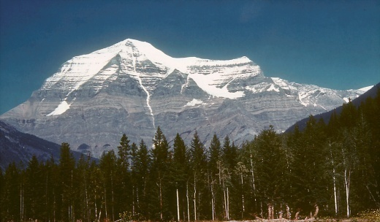
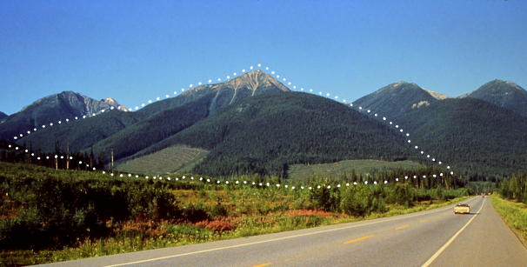
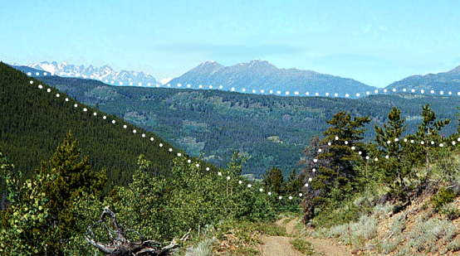
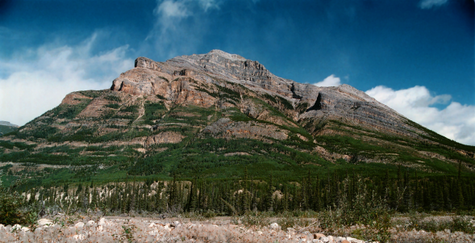
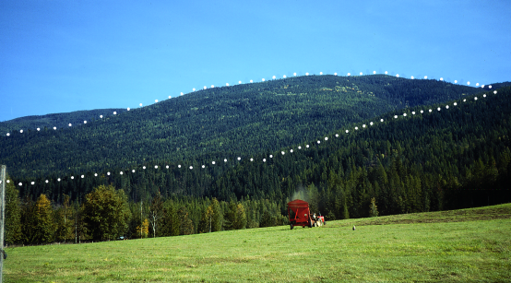
Visual Landscape Inventory
The VSC rates the sensitivity of the landscape to visual alteration
based on biophysical and Viewing characteristics.
Class 1 is very high sensitivity to alteration.
Class 5 has a very low sensitivity to alteration.
1
3
5
2
4

Slide 33
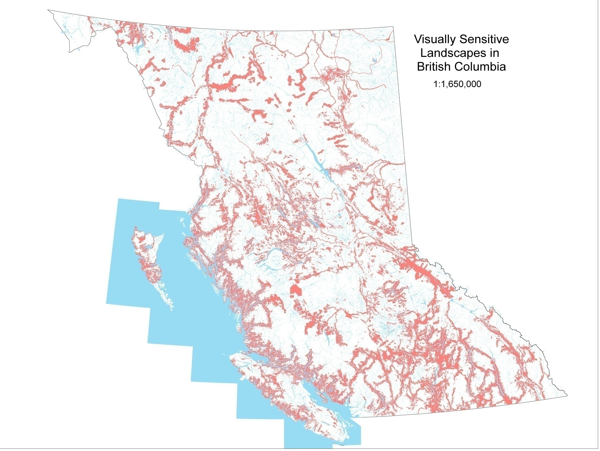
14.5 Million hectares of Visual Landscape Inventory.

Slide 34
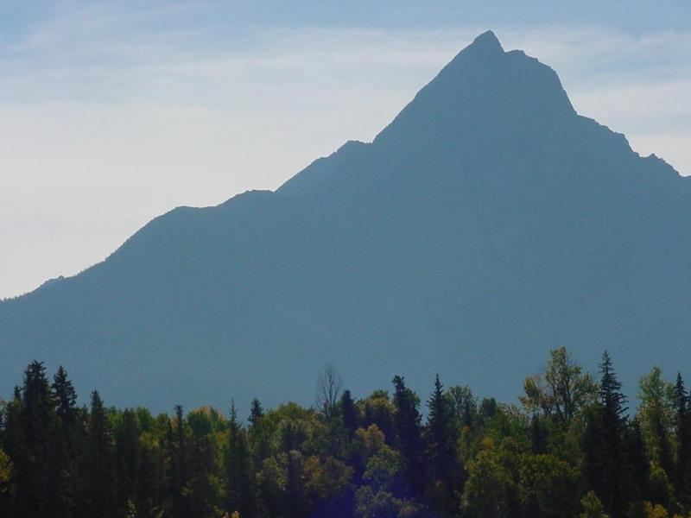
Facts & Figures
Province 95 million hectares
VLI inventory area 14.5 million ha (17%)
Established VQOs 10.5 million ha (11%)
THLB within Province 18.9 million ha
THLB restrictive VQOs 1.5 million ha (1.6% or 8% of THLB)

Slide 35

Example of some local Scenic Areas
North Island Highway 19
Hwy 4 to Pacific Rim
Clayoquot Sound
North & Central Coast
Johnstone Strait
Rivers Inlet
Sea to Sky Hwy 99
Coquihalla Hwy 5
Inside Passage
etc.

Slide 36

Visual Landscape Inventory
Maps visible terrain.
Viewpoints, travel corridors, communities.
Records biophysical & social factors
Typically 1:20,000 to 1:50,000

Slide 37

Visual Sensitivity Units … a.k.a. visual landscape polygons
EVC Existing Visual Condition ... amount of visual alteration
VAC Visual Absorption Capability ... Measure of diversity veg + terrain
BR Biophysical Rating ... Slope, aspect, topographic relief
VC Viewing Condition ... Viewpoints, distance, duration
VR Viewer Rating ... # viewers, expectations
VSC Visual Sensitivity Class ... Sensitivity of landscape to alteration

Slide 38

Understanding the VLI inventory Coding
When the Inventory mapping is complete a map label is applied to each polygon.
Polygon No.
Visual Absorption Capability
Existing Visual Condition
Viewing Condition:
Biophysical Rating
Viewing Rating
Visual Sensitivity Class

Slide 39

Visual Landscape Inventory data is housed in Governments
BC Geographic Warehouse
Available on viewers such as Mapview.
R
PR
M
Note current problems with NICC. When in doubt confirm with district/region. Check for GAR orders.

Slide 40


Viewpoints
Single town, park, etc.
Multiple highway, river, valley
continuous lake, marine passages
For the purposes of FRPA (defn):
A Significant Public Viewpoint means:
“ a place or location on the water or land that is accessible to the public, provides a viewing opportunity and has relevance to the landscape being assessed”.

Slide 41
Choosing Viewpoints for Evaluations
Examples of viewpoints that might be considered when
doing an evaluation or visual impact assessment:
a stretch of highway or waterway leading toward a harvest unit,
a rest stop,
a recreation site or park,
a group of homes, or settlement, or
a tourist-related commercial enterprise.
It is important to review the location(s) offering the best or most direct view of the alteration. (aka worst-case scenario) This may not necessarily be a viewpoint that provides a stationary or stopping location.
Warning: Visual Landscape Inventory viewpoints were used to derive visual sensitivity unit boundaries and for rating the sensitivity of the landscape.
They were not derived for use to assess VQO compliance.

Slide 42

Existing Visual Condition (EVC)
Scale of Existing Alteration
Influence of Visual Landscape Design
Influence of Site Disturbance … roads, landings
Influence of Vegetative Colour & Texture (green-up)

Slide 43

Non forestry visual alterations:
Urban and rural settlement
Roads, highways
Hydro and transmission lines
Independent Power Projects
mines, gravel pits, dams

Slide 44

Wind turbines and associated powerlines are a future concern. Preliminary research indicates the public are divided on whether the towers are viewed as positive “green” attractions vs negative distractions in the landscape.
Maui

Slide 45



Insect (beetle) killed trees changing interior landscapes.

Slide 46



Wildfire changing the face of landscapes.

Slide 47

low
moderate
Visual Absorption Capability (VAC):
“relative ability of a landscape to accept management manipulations without significantly affecting its visual character”
Slope
Aspect
Surface Variation
Rock/soil/Vegetative Variety
high

Slide 48

Biophysical Rating (BR)
Slope
Aspect
Edge
Topographic Variety
Vertical Relief
Vegetation Variety
Influence of Rock/Soil
Influence of Water
Influence of Adjacent Scenery

Slide 49

Viewing Condition (VC)
Viewing Distance (fore/mid/background)
Viewing Frequency … number of viewpoints
Viewing Duration
Viewing Angle

Slide 50

Viewing Distance
Background 8+ km
Midground 1 – 8 km
Foreground 0 – 1 km

Slide 51

Viewing Duration
Static/stationary …… long
Hiking/boating ……….moderate
Vehicle ………………. short

Slide 52


Season, weather, daytime, lighting can greatly influence visual appearance of landscapes.
Mount Benson

Slide 53

Viewer Rating (VR)
Number of viewers
Viewer Expectations
Moderate number of viewers
Moderate to high viewer expectation
(Seven Sisters Mountain Provincial Park, Hwy 16)

Slide 54


Viewer Expectations
Few viewers but high expectation for wilderness and pristine visuals.
As opposed to:
High viewer numbers with little expectation for visual quality.
Current controversy with
Discovery Islands Tourism Association
and sea kayaking.

Slide 55


Visually Effective Green-up.
Visually Effective Green-Up is well defined and has been around since the mid 1990’s. It was a requirement under the Code for adjacency and was defined in the VEG research report, Green-up Guidebook and VIA Guidebook.
Visually Effective Green-up (VEG) “is the stage at which the regeneration on a cut block is perceived by the public as a newly established forest. The forest cover on the cut block should generally be of sufficient height to block stumps logging debris and bare ground from view”.

Slide 56




Visually Effective Green-up.
VEG Ratings
1 = Not at all greened up.
2 = A little
3 = Quite
4 = Very
5 = Fully greened up.
GV 1.15 Ht .6 M
VEG Yes
GV 1.88 Ht 3 M
GV 3.0 Ht 10 M
GV 4.4 Ht 22 M

Slide 57

Visually Effective Green-up.
The tree height to achieve VEG will vary based on biophysical variables and site conditions. Table 1 provides a guide to recommended green-up heights to meet VEG by slope.
Table 1 can be used to predict when to re-enter a landscape by determining when a specific species will reach the desired tree height given the specific site conditions. E.g. if it requires 8 years for a tree to reach 3 meters on a 0-5m slope, that would be your re-entry timing.

Slide 58



1993
North Island
Highway 19
2000
2004

Slide 59

Summer Visually Effective Green-up

Slide 60

winter Visually Effective Green-up?
Where important, may require higher Visually Effective Green-up (VEG) height before adjacent forest harvesting.

Slide 61
Visual Landscape Design
Definition “the organization of a place in a way which reconciles the conflicting requirements of use while ensuring an attractive appearance”.
In forest setting, this means organizing the component stands of the forest and the way they are logged and regenerated while an attractive appearance is maintained.
A good visual design is one where the chosen variables and modes of organization are positive and harmonious.
A bad visual design is where they are negative and disharmonious, irrespective of personal taste or preference.
The key tool for meeting VQOs.

Slide 62
Visual Landscape Design Training Manual, MOF, 1994
2 day training course:
Visual Landscape Design Concepts and Principles
Landscape Character Analysis … lines of force
Visual Landscape Design Applications
Design Techniques
Integrated Visual Design Process

Slide 63

Response to Visual Design
M
PAR -.41
The better the design the greater the Public Acceptance.
34 ha
Good Design
MM
PAR -1.49
Design is the fitting of forest harvesting into the landscape using recognised concepts and principles to make them aesthetically acceptable.
Poor Design
29 Ha

Slide 64




Opening Shape is Important
Geometric angular shapes Not Preferred
Interlocking curve-linear shapes Preferred

Slide 65

Cutblock shape
benefits from large sweeping curvilinear shapes
Avoid unnatural straight block boundaries & angular corners
North Island Highway 19, NICC Forest District

Slide 66


Edge Treatment
Not Preferred
Preferred
Harsh, straight line boundaries
Softer, rounded, graded edges

Slide 67


Use of Screening
Thin and ineffective screening
A better solution
“tidy , clean, green, healthy”

Slide 68

Strategic placement of reserves and wildlife tree patches
for visual buffering.

Slide 69



Roads & Skid Trails
Roads and skid trails can create long lasting and intrusive visual impacts.

Slide 70


Roadside Cleanup
Unacceptable
Acceptable

Slide 71

Visual Impact of Roads
long lasting visual impacts of roads
Nimpkish Lake, TFL 37

Slide 72

Highway Foreground Visual Management
Tidy, clean & green
Slash location & disposal
Hydro seeding
Interpretative Signage
May 2005 Forest Practices Board audit of VRM in Campbell River Forest District highly critical of roadside harvesting.
Highway 19 Campbell River Forest District

Slide 73




    Choice of Silvicultural System
    (landscape Level)
Clear cut
Retention
Selection
Least Preferred
Most Preferred
Public Preference

Slide 74



    Choice of Silvicultural System
    (Site Level)
Patch cut
Retention
Selection
Least Preferred
Most Preferred
Public Preference

Slide 75






#16
#64
#61
#35
#28
PAR +1.4
3
PAR +1.2
PAR +0.8
PAR -0.2
2
PAR +0.3
#45
1
Average PAR
PAR -0.6
0
#40
-1
-2
Province (n = 714)
Tourists (n = 181)
PAR -0.7
-3
Natural
Patch Cut
Seed Tree
Clear Cut
Single Tree
Selection
Fir Reserve
Retention
Sanitation Cut
Aggregated
Shelterwood
Group Selection
Dispersed Retention
Silviculture treatments that leave trees behind are preferred
Silvicultural System (specific)

Slide 76

Selection harvest
- significant visual benefits
- textural changes
Menzie Mtn. 25% stems removed, 2nd growth Douglas Fir, Sayward Forest

Slide 77

Selection Logging, approximately 10% stems remaining
Even low density selection logging can be visually beneficial when viewed obliquely and from a distance. Research indicates threshold of approximately 25% stems/basal area retained being visually effective.

Slide 78

Example of Selection logging in the Kootenay landscape
40-50 % volume/stems removed from lower half of hillside.

Slide 79

Application in the CC LRMP & NC LRMP

Slide 80

Sequencing … distributing cuts over time and space.
North Island Highway

Slide 81
Golden Rules of Visual Landscape Design
Use Lines of Force to influence shape of openings.
Use curvilinear lines over straight horizontal and vertical lines.
Start low on the landscape and work up.
Work from big scale to small scale.
Shape more important than scale where public concern is an issue.
Use soft rounded shapes in rolling topography and use spiky shapes in steep topography.
Make use of interlocking shapes to improve fit.
Avoid contrasts in colour and shape as these create figure and ground problems.
Do not leave consistent intervals between blocks.
Vary texture by introducing small blocks or through partial cutting.

Slide 82

Example of completed visual force analysis
Determining the degree to which forest harvesting & road building reflects/responds to the major lines of visual force is a key indicator of design quality.

Slide 83


Visual Impact Assessments “VIA”
Forest Practices Code Guidebook 1995/2001
used to estimate the potential visual impact of proposed operations on scenic resources and to assess whether the VQO’s would be achieved.
photographs, sketches, dtm’s, computer graphics.
Visual Simulations
Sophisticated computer visualisation systems are now available to present much more realistic pre- harvest simulations.

Slide 84

Computer Simulation using World Construction Set
More on VIA’s this afternoon

Slide 85
Managing for Visual Quality
Up until this point, we have learned about public perceptions, visual inventory, visual design, and visual impact simulation.
None of this process has occurred in the legal world.
To enable management under FRPA we need two things are required:
  the designation of a scenic area and
  the establishment of a VQO
Both actions are required!

Slide 86

Scenic Areas
What are Scenic Areas?
Similar to Land Use Plan, Special Resource Management Zones.
By definition they are visually important areas that require special management because of their physical characteristics and public use/concern.
Examples: highway corridor, marine inlet, lake or river viewshed.

Slide 87

Scenic Areas
Under FRPA scenic areas are designated under
the Government Action Reg. Sec. 7(1)
The authority to create, delete, or modify scenic area
boundaries in response to new VLI information has
been delegated to the Resource District Manager.

Slide 88



Visual Quality Objectives
VQOs are management objectives established by the DM under the Government Action Regulation Sect 7(2), grand parented under FRPA, or set through orders under the Land Act. They are used to reflect society’s desired level of visual quality on the landscape.
The Forest Planning and Practices Regulation S.1.1 defines 5 categories of alteration:
Preservation, Retention, Partial Retention, Modification & Maximum Modification.
Retention
Partial Retention
Modification

Slide 89

Visual Quality Objectives
Preservation:
Alteration, when assessed from a significant public viewpoint, is:
very small in scale, and
not easily distinguishable from the pre-harvest landscape.
Predicted by 0% alteration of landform.

Slide 90


Visual Quality Objectives
Retention:
Alteration, when assessed from a significant public viewpoint, is:
(i) difficult to see,
(ii) small in scale, and
(iii) natural in appearance.
0.3%
Predicted by 0 - 1.5% alteration of perspective landform
0.9%

Slide 91

Visual Quality Objectives
Partial Retention:
Alteration, when assessed from a significant public viewpoint, is
(i) easy to see,
(ii) small to medium in scale, and
(iii) natural and not rectilinear or
geometric in shape.
3.1%
Predicted by 1.6 - 7.0% alteration
of landform in perspective.
5.3%

Slide 92


Visual Quality Objectives
Modification:
Alteration, when assessed from a significant public viewpoint, is
is very easy to see, and
is (A) large in scale and natural in its appearance, or (B) small to medium in scale but with some angular characteristics.
5.9%
7.3%
Predicted by 7.1 – 18.0% alteration

Slide 93


Visual Quality Objectives
Maximum Modification:
Alteration, when assessed from a significant public viewpoint, is
very easy to see, and (ii) is
(A) very large in scale,
(B) rectilinear and geometric in shape, or
(C) both.
19.0%
11.8%
Predicted by 18.1 – 30.0 % alteration

Slide 94
VQO / VQC % Perspective % Plan for TSR analyses
Preservation 0 0 – 1
Retention 0 – 1.5 1.1 – 5
Partial Retention 1.6 – 7.0 5.1 – 15
Modification 7.1 – 18.0 15.1 – 25
Maximum Modification 18.1 – 30.0 25.1 – 40
note: ranges apply to total “green” area of landscape/landform unit,
for clear cutting only.

Slide 95
How are VQOs established?
Under the GAR S. 2 there are 3 tests that have to be met
prior to the District Manager signing off a government order to
establish/change/de-establish VQOs.
the order is consistent with (other) established objectives.
the order will not unduly reduce timber supply.
order must not adversely effect ability of agreement holder to exercise harvesting or grazing rights.
In addition to the above tests GAR 3(2) requires that the DM
provide holders of agreements under the Forest Act or the
Range Act that will be affected by the order with an opportunity for
review and comment. Other key stakeholders that may be affected
should also be consulted, inc. First Nations, public, tourism, etc.

Slide 96
Establishing VQOs (continued)
Once the tests have been addressed and key stakeholders,
Forest agreement holders, and First Nations have been consulted
the District Manager can proceed with writing an order establishing,
amending or canceling VQO’s
Once the Order has been written and signed by the District
Manager GAR Sect. 4 (2)(a)(b)&(c) requires the order to be
posted on the MFR website, published in the B.C. Gazette and made publicly available at the regional office.

Slide 97


Sample VQO Order & Map
15

Slide 98

Sample Gazette Notice

Slide 99

http://www.for.gov.bc.ca/tasb/legsregs/frpa/frparegs/govact/orders/
Note: Since FRPA and FPPR grand parented most objectives, you will only find orders for new VQO’s or changes to old VQOs.

Slide 100

P 1%
R 13%
PR 52%
M 30%
MM 4%
109,746 Ha.
1,326,945 Ha
5,395,445 ha
3,177,422 ha.
461,301 ha
VQOs established on 10.5 million hectares of gross provincial land base. 72% of inventoried area has a VQO.

Slide 101
Forest Stewardship Plan
VQO Requirements:
A FSP must specify intended results/strategies, in relation to OSBG for visual quality or for established VQOs. FRPA 5(1)(b)(i)&(ii)
The Results/Strategies must be consistent with OSBG for visual quality and with established VQOs. FRPA 5 (1.1)
Each intended result or strategy in a FSP must be consistent with the established objective to the extent practicable. FPPR 25.1.
The holder of a FSP or a woodlot licence plan must ensure that the intended results specified in the plan are achieved, to the strategies are carried out. FRPA Section 21(1).

Slide 102
Forest Stewardship Plan
What should a DM be looking for in an FSP with respect to Visuals?
FDU’s to identify location of Scenic areas.
There must be a R/S for Scenic Areas with VQOs.
The Result/Strategy must be be measurable, verifiable and describe the circumstances where they apply and must be consistent with the established VQO.

Slide 103

Compliance and Enforcement
The third pillar of the FRPA functional architecture is compliance and enforcement.
FSPs
VQOs
R/S

Slide 104


Compliance and Enforcement
Compliance and Enforcement (C&E) is
the law enforcement program of the MFLNRO.
It’s role is to ensure that forestry
laws are being followed in B.C.'s public
forests, and to take action where non-
compliance is believed to be occurring.

Slide 105

Compliance and Enforcement
There are two areas under FRPA that C&E may wish to examine with respect to visuals.
Review FSP Results or Strategies to ensure that they are measurable and verifiable.
Inspect post harvesting results, to ensure the visual quality objective(s) have been achieved.

Slide 106

Compliance and Enforcement
To carry out their activities C&E are provided with powers to inspect and investigate.
Inspections: are conducted routinely to verify compliance. They provide government with a mechanism to detect problems and are used to encourage compliance.
Investigations: are systematic processes that collect evidence and information relevant to a suspected contravention.

Slide 107

Visual Investigations
An Investigation may be triggered when:
there have been public complaints regarding visuals.
licensee performance has been worse than average.
high public concern for the landscapes with restrictive VQO’s.
Forest Practice Board audits have identified problems.
a C&E risk assessment identifies the risk as high.
poor harvesting practices have affected other business opportunities.
FREP Evaluation work has identified VQO performance issues.

Slide 108

Visual Inspection Procedures
To assist C&E to do its work,
a visual inspection manual has been
developed.

Slide 109

C&E Visual Inspection - FREP Visual Quality
Effectiveness Evaluation Procedures
The visual inspection process evaluates compliance with the VQO from selected viewpoints using two independent measures:
each category of alteration (VQO) is evaluated using an ocular “eye” assessment and compared to the legal definition;
the perspective percent landform alteration and design elements are assessed using standards and criteria derived through research.
Priority is given to meeting legal definition. (FRPA s. 1.1)

Slide 110
Compliance and Enforcement
Non-compliance addressed by:
Administrative remedies- remediation orders, administrative penalties, suspension or cancelation of agreement.
Court action- violation tickets, prosecution.
Complaint to the professional body and disciplinary action.

Slide 111





Provincial Sample Cases
Opportunity to be Heard (OBTH) Decisions
Pryce Channel- Sunshine Coast
Red Sands Lake- Kalum
PR not achieved – Not Compliant
Found to be compliant with PR
Bowron Lake- Prince George
Powell Lake- Sunshine Coast
PR not achieved – Not Compliant
Found to be compliant with PR
Guyishton Lake- Nadina District
PR not achieved – Not Compliant

Slide 112

Coast Area examples of VQO C&E activities
Powell Lake Sunshine Coast District
Pryce Channel Sunshine Coast District
Lake Errock Chilliwack District
Coquihalla Hwy Chilliwack District
Skidegate Channel Haida Gwaii District
Howe Sound Squamish District
Alberni Canal South Island District

Slide 113

Google Earth oblique view of Powell Lake & Goat Island
Example 1 Powell Lake
*
CP OL 543

Slide 114

Mid Lake Viewpoint, near Powell Lake Lodge.
slight telephoto lens.
Unnatural appearing geometric “half donut”.
Straight appearing upper boundary.
Visual impact of road cuts.
July 2004 L. Davies

Slide 115

District Manager did not find licensee in non-compliance.

Slide 116


Reserve patches nearly invisible.
Actual photograph
DTM did not accurately reflect actual harvest visual impact.
Digital Terrain Model

Slide 117

Pryce Channel- design critique
Very easy to see, medium to large in scale, some angular characteristics.
11.75% and 15.17% landform alteration (unadjusted for design).
Achieved a Modification VQC.
Licensee found in non-compliance, penalized $5,000.

Slide 118

Google Earth high elevation oblique of Lake Errock
Example 3 Lake Errock, Chilliwack Forest District
Location of CP 39 & 40
Harrison River
Lake Errock
Highway 7

Slide 119

CP 39 & 40 viewed from Lake Errock Store (Hwy 7)
Establish VQO= Partial Retention Resulting in Modification VQC
2 Public complaints to District Manager.
Public complaint to Forest Practices Board.
FPB Board Investigation.

Slide 120

Information provided by licensee indicates that blocks 39 & 40 will be obscured from view by roadside vegetation.
Visual modelling and viewpoint photography don’t appear to be correct.

Slide 121

South shore of Lake Errock, July 21, 2006
Recommended VQC = Retention
DM approved maximum alteration = 2.9%
Resulting landform visual alteration = 15% perspective
Achieved a Modification VQC (7.1 – 18.0%) …. approaching MM.
C&E chose not to pursue further action.
Square and rectilinear shape, minimal edge design.
Large perspective scale, dominates landform.
Insufficient reserve patches.
Lloyd Davies

Slide 122

Example 4 Coquihalla Highway 5, Chilliwack Forest District
West side of Coquihalla Highway, extended foreground viewing (85 sec.)
Public complaint to District Manager.
High visual sensitivity … 2.7 million passenger vehicles/year.
High scenic quality… established Retention VQO.
In-field review Sept. 2008.
very easy to see, large in scale, angular characteristics.
18.7% alteration
Modification VQC… verging on Maximum Modification.
District decided to address on a professional basis ... outside of formal C&E.

Slide 123

Example 5 Skidegate Channel, Haida Gwaii District
Scenic Corridor for boaters.
Established Partial Retention VQO.
Public, Town Council, and Haida Nation expressed concerns.
C&E requested regional assistance to evaluate visual impact.
Report and finding provided ... pending C&E action.
Forest Practice Board investigation proceeding.

Slide 124


Example 8 Alberni Canal South Island Forest District
20 % alteration
Angular corners
Straight boundary lines
Insufficient in-block retention
Issue dealt with licensee professionals.

Slide 125





1. Alberni Canal South Island Forest District
Established VQO = Partial Retention
Harvesting by Tseshaht First Nation (BCTS FSP), also privateland by Island Timberlands

Slide 126

Crash Course in Forest & Range Evaluation Program
Visual Quality Effectiveness Evaluation

Slide 127


FREP Effectiveness Evaluation
Used to determine if current legislation, policy and procedures are effective.
These procedures & standards were developed to be applied to a single block or may be used more broadly at a regional or provincial level.

Slide 128


Understanding the Landscape
The existing MFR Visual Program was developed to address alterations on the mid-ground & background landscapes.
More than 8 Km
Background
Midground
1- 8 Km from viewer
Foreground
0-1 Km from viewer
We are only now conducting the research necessary to manage the foreground views.

Slide 129

We manage alterations on landforms as opposed to the total scene.
Background Not Included
Landform outlined in yellow
Foreground Not included
Landform: a distinct topographic feature that is three dimensional in form and is generally
defined by ridges, valleys, shorelines and skylines. Examples include hills and mountains.
80% of the time landforms are reasonably easy to define.

Slide 130
Measuring % Alteration
Completed on photographs
B
A
C
Area
B + C
% Alteration
Total Green Landforms
X
100
=
Area
A
33

Slide 131

Completing the
Effectiveness Evaluation Form
We will now work through the various components of the EE form.
The coloured sections will be more fully explained as we progress through this slide show.
There are two streams one for clear cuts and one for partial cuts. Section 2.3.4 deals with partial cuts and won’t be discussed.

Slide 132

Assess Basic Definition
Step 4:
Using the written definitions of visual quality classes in Table 1 of the EE form, compare their descriptions to the alteration present on the landscape …
ocular “eye” evaluation.
Determine which category of alteration (achieved VQO) is the best fit and identify the class on the bar graph. You may wish to refine your initial determination by identifying whether the determination is toward the low, mid or upper range for the class.
Record any relevant notes, ie. viewing context, duration, etc.

Slide 133

5.3.4 Assess Visual Design
0
+1
+1
-1
+1
+2
Step 5:
Determine the influence of visual design, by answering the following questions with a Good, Moderate or Poor response.
1. Does the alteration respond to the major lines of force?
2. Does the alteration borrow from the natural character of
the landscape?
3. Have edge treatments been incorporated?
4. How far is the alteration from the viewpoint?
5. What position does the alteration occupy on the landform?

Slide 134
Assessing Initial VQC
11.7
0
11.7
M
Step 6:
The Initial VQC rating is assessed by measuring the scale of alteration on the landform and comparing the result with the percent alteration ranges in Table 2 below.
Visual Quality Class | Alteration % of landform in perspective view
P - Preservation | 0
R - Retention | 0 – 1.5
PR - Partial Retention | 1.6 – 7.0
M - Modification | 7.1 – 18.0
MM - Maximum Modification | 18.1 – 30.0

Slide 135
Adjusting Initial VQC
X
+1
X
0
+2
+3
16.6
Step 7: Adjust Initial VQC
The initial % alteration figure (derived earlier from the photographs) is adjusted upward or downward, depending on the degree of positive or negative visual influences. Three aspects of the visual scene (site disturbance, tree retention & design) are assessed on a qualitative scale.

Slide 136
Determining the final EE rating for the landform
Step 8:
Compare the Basic VQC determined using the definitions, with the adjusted VQC derived using percent alteration measurements and rate the opening by marking the appropriate box in section 2.3.5 of the EE form.
The two evaluation methods will usually result in similar ratings, although they may lie on either side of a class boundary.
x

Slide 137

The good, the bad, ……

Slide 138
the Ugly ?

Slide 139

References and further reading:
Forest Landscape Handbook, MOF, 1981
Visual Landscape Design Training Manual, MOF, 1994
A First Look at Visually Effective Green-up in BC, MOF, 1994
Clearcutting and Visual Quality, A Public Perception Study, MOF, 1996
Visual Impacts of Partial Cutting, Summary Report, MOF, August 1997
Visual Landscape Inventory, Procedures & Standards Manual, MOF, 1997
Visual Impact Assessment Guidebook, MOF, January 2001
VRM Website: http://www.for.gov.bc.ca/hfp/fordev/visual_resource_mgnt.htm

Slide 140

Visual Impact Assessment overview

Slide 141


Visual Impact Assessment
Workshop
Presented by:
Jacques Marc RFT
Visual Resource Management Officer
Resource Practices Branch
Jacques.marc@gov.bc.ca
Ministry of
Forests, Lands and
Natural Resource Operations

Slide 142

Visual Impact Assessment
What is a Visual Impact Assessment (VIA)?
It is an assessment of the predicted visual impact of a forestry operation(s) in perspective view and is done from “significant public viewpoints”.
Ken Fairhurst , Resource Design Inc.

Slide 143
Visual Impact Assessment
Why do we do them?
  Visual Impact Assessments were a legal requirement under the Forest Practices Code.
  They are not a legal requirement under FRPA.
  However, due diligence suggests that some level of assessment is required in order for a professional to demonstrate that the results/strategies prescribed in the FSP will be consistent with the legally established VQO for an area.
  The ABCFP Standards of Professional Practice require RPFs and RFT’s to exercise due diligence in completing their work. Completing a VIA to an appropriate standard would be evidence of this when managing for visual quality.

Slide 144
Visual Impact Assessment
A VIA is more than just a visual simulation!
It is an iterative process that involves:
Selecting viewpoints
Describing the landscape’s visual character
Simulating views of proposals from the viewpoints
Evaluating the simulations to determine if the VQO(s) would be achieved.
Adjusting block(s) pattern, shape and road location as necessary
Photographic evidence and supporting documentation

Slide 145

Visual Impact Assessment
The VIA Guidebook was released as part of the Forest Practices Code and still provides sound technical advice.
It suggests that the level and detail of a VIA may vary depending on a number of factors e.g. VSC, numbers of people, level of public concern, range of viewing opportunities, and established VQO.
The VIA Guidebook is planned for update in 2013/14.

Slide 146
Visual Impact Assessment
In situations with a highly sensitive landscape and/or large numbers of viewers and/or high number of viewpoints, an extensive VIA may be required.
An extensive VIA would include digital terrain modeling, photographic panoramas, VIA forms, and TRIM contour mapping with viewpoints identified.
In situations with a less sensitive landscape a map, form, and photograph of the area with an overlay showing relative block size, location and configuration may be appropriate.

Slide 147
Step 1
Identify VQO and choose
potential viewpoints
Flow chart showing
steps involved in conducting a VIA
Step 2
Visit & viewpoints, take photos
& collect field information
Step 3
Develop design options and prepare visual simulations
Visual landscape design
is the foundation of the entire process
Step 4
Assess visual
simulations relative to VQO
Step 5
Prepare a visual impact assessment report
8

Slide 148
Selecting Viewpoints
Step 1
Identify VQO and Determine Potential Viewpoints
Viewpoints that might be considered when doing an VIA:
a stretch of highway leading toward a harvest unit (i.e. focal view)
a rest stop,
a recreation site or park,
a group of homes, or settlement, or
a tourist-related commercial enterprise.
It is important to review the location(s) offering the best or most direct view of the alteration. This may not necessarily be a viewpoint that provides a stationary or stopping location.
Same alteration may need to be assessed from multiple viewpoints.
Warning: Visual Landscape Inventory viewpoints are used to derive visual sensitivity unit boundaries and to rate the visual sensitivity of the landscape.
They are not derived specifically to assess VQO compliance.

Slide 149

Step 1
Identify VQO and Determine Potential Viewpoints
Proposed
Opening

Slide 150


Step 2
Visit Viewpoints & Take Photos
Proposed Blk.
Visit Potential viewpoints using the travel mode that would be used by the public.
A
B
C
Lone Tree Point
Record viewpoint data

Slide 151
Step 2
Record Viewpoint Data
In the field, visit your pre-selected viewpoint(s), add or delete from them depending on viewing conditions, take photos and record particulars of each viewpoint and the view of the proposed opening. This includes: GPS coordinates, elevation, viewing direction, and distance to the alteration. Record camera lens used in mm. This data will be required to produce an accurate simulation of the landscape.
1
117º 59’ 26.7
56º
50º 41’ 58.7
518 M
5 KM
26º
NKN 024-027
Lone Tree Point
10º
Important Note:
It is important to ground proof your viewpoint(s) selection to ensure that all the possible view angles have been covered.

Slide 152
Taking Photographs
Weather should be clear (80-100% cloud free is ideal)
Illumination is strongest in the summer months.
Use a high-resolution dSLR digital camera.
Take two sets of photos from each viewpoint:
- one set at 50-70 mm (human eye equivalency)
- the second set zoomed in to capture landform detail.
Often a series of overlapping photographs (25% overlap
minimum) are required to capture the entire scene.
Panoramas can benefit from tripod (but not on boat).

Slide 153



Taking Photographs
Side Lighting
Front Lighting
Back Lighting
Detail & landform accentuated
Strong detail, colour & texture
No detail, eye drawn to skylines
East-facing units are best photographed in the morning, west-facing units are best photographed in the afternoon.
Plan your day accordingly.
Side-lighting is beneficial for accentuating terrain detail.

Slide 154
Splicing Panoramas
In those cases where you have taken multiple overlapping images they have to be stitched together.
Some digital cameras come with a panorama basic stitching software. There is also other digital stitching products available on the open market. Some examples:
http://www.arcsoft.com (Arcsoft Panorama Maker 6)
http://www.panavue.com (Image Assembler)
http://www.cs.ubc.ca/~mbrown/autostitch/autostitch.html
http://www.panoguide.com (How to Guide)

Slide 155






Step 3
Develop Design Options and Prepare Simulations

Slide 156
Golden Rules of Design
Use curvilinear lines over straight horizontal and vertical lines.
Start low on the landscape and work upwards.
Shape is more important than scale where public concern is an issue.
Use soft rounded shapes in rolling topography and use more spiky shapes in steep angular terrain.
Do not leave consistent intervals between blocks.
Vary texture by introducing small blocks or through partial cutting.
Use mapped lines of force to generate block shape(s).
Make use of interlocking shapes to improve fit.
Avoid sharp contrasts in colour and shape.
Asymmetric balance more comfortable than symmetry.

Slide 157


Golden Rules of Design
Example:
Use soft rounded shapes in rolling topography and use more vertical
shapes in steep & angular terrain.

Slide 158

Step 3
Develop Design Options and Prepare Simulations
Prepare a simulation from each viewpoint visited in the field
to determine how a proposed opening/road would look like on the landscape.
Each simulation should be created using GPS Coordinates for the photo location, use the same camera lens (angle) , make use of tree heights consistent with the forest cover file or measured in the field and view the landscape along the same bearing as seen in the field.
Blair Allen-Viewscapes 3D
When done correctly a simulation will drape over the original photo and the features should match closely.

Slide 159
Step 3
Confirm Accuracy of Simulation
Viewpoint correct
View angle and direction are correct
Lens size matches camera lens used
Tree ht in foreground and at edge of block
correspond with Inv tree hts. or as measured in the field.
Leave areas are correctly positioned
No vertical or horizontal exaggeration
No apparent anomalies in simulation.

Slide 160


Step 3
Confirm Accuracy of Simulation
Why do you think actual opening appears larger in real life vs. simulation?

Slide 161
Step 4
Assess Visual Simulation Relative to VQO
DEFINITION:
All existing and proposed operations must be consistent with the definition for the specified VQO from each viewpoint. This is an ocular assessment which examines size, shape and design of the alterations relative to the landform being assessed.
DESIGN:
Visual design of proposals is critical to achieving VQOs. Alterations that borrow from natural characteristics will more easily achieve VQOs and receive public support.
Numerical Assessment:
Based on research, we have learned that some numerical data such as % landform alteration for clear cutting and stems/volume removed for partial cutting can be good predictors of VQOs.

Slide 162


Understanding the Landscape
The existing visual resource management program was developed to address alterations on the mid-ground & background landforms.
Background
Midground
Foreground
We are only now conducting the research necessary to manage the foreground views.

Slide 163
Step 4
Assess Visual Simulation Relative to VQO
Landform vs. Landscape
The term landform was used under the Forest Practices Code to define the unit against which to measure and evaluate forest alterations.
Ref: Visual Impact Assessment Guidebook 2nd Edition January 2001 and Clear‐cutting and Visual Quality: A Public Perception Study, BC Ministry of Forests, November 1996.
The word landscape appears in the Categories of Alteration definitions in the FPPR section 1.1. Landform is a subset of landscape. All MFLNRO research is based on landform so this is the most appropriate unit against which to measure VQO accomplishment.
Landforms often occur in different distance zones (foreground, mid‐ground and back ground). These distance zones are usually distinct landforms because they are usually separated by incised valleys, creek draws or topographic breaks. Measuring perspective scale of alteration is done relative to individual landforms as opposed to broader landscape scenes or panoramic views composed of multiple landforms.

Slide 164

Defining a landform
Background Not Included
Landform outlined in yellow
Foreground Not included
Landform: a distinct topographic feature that is three dimensional in form and is generally
defined by ridges, valleys, shorelines and skylines. Examples include hills and mountains.
Most of the time landforms are reasonably easy to define.

Slide 165


Distinct Landforms in Vertical Landscape
Layered Landforms in Horizontal Landscape

Slide 166

Area
For Landforms with Rock Snow & Ice
C
% Alteration
X
100
=
Area
B
A
Non Green
B
C
Green
(Includes inoperable)
Alteration
L. Davies

Slide 167


Shoreline Treatment
Greater than a Kilometre include Shoreline Trees
Less than a Kilometre exclude Shoreline Trees
39

Slide 168

Areas B + C (.37)
Landform A (2.98)
= 12.4%
A
C
B

Slide 169
Assessing Visual Design
Assessing the visual design of a cut blocks and roads is an important aspect of the evaluation process. The full range of concepts and principles to be evaluated are set out in the VLD Training Manual. Two day design workshops are generally offered periodically.
One of the key questions that must be answered is whether or not the major visual lines of force were identified and used to develop the block shape.
The lines of force concept is based on the premise that as we observe the landscape, our eyes are drawn up hollows and down ridges.
Learning how to map and use visual force analyses is an important design concept to learn and understand as it is used as the basis for developing cut block shapes that are more compatible with the natural landscape.

Slide 170


Slide 171
Evaluating VIA Results
Basic definition:
Which category of alteration (VQO) definition best describes your proposed operation? Is it consistent with the objective?
Visual design:
Does a proposed operation respond to lines of force and exhibit elements of good visual design?
Numerical assessment:
In perspective view, what proportions of the landform are represented by your proposal and any existing non-visually effective green-up alterations? What percent volume or stems will be left in the block? Is the percent alteration number within the parameters for the established VQO?

Slide 172
Evaluating VIA Results
The rigorous visual Impact assessment approach assesses each view using two independent measures:
the basic definition for each category of alteration (VQO) is evaluated through an ocular assessment and;
the perspective percent alteration and design elements are assessed using standards and criteria derived through research.
The two measures are combined to determine a final rating of VQO achievement.

Slide 173


Assessing a Visual Simulation
What visual condition would this proposal achieve?
Foresite Consultants Ltd.
Define landform Unit for analysis purposes.
Conduct ocular assessment using definitions.
Conduct numerical assessment.
Evaluate Design

Slide 174

Analysis
Alteration 3%
Avoid mapping lake shore trees as they are in foreground i.e. less than 1 Kilometer away.
Ocular assessment: Opening easy to see, small in scale and natural in appearance.
Percent Alteration 3%
Design : Response to Lines of Force Moderate.
Result: Partial Retention

Slide 175

Assessing a Visual Simulation
What visual condition would this proposal achieve?
consider landform
ocular assessment using VQO definitions
Landform scale % alteration.
Design
Ken Fairhurst , Resource Design Inc.
53

Slide 176

Analysis
Landform avoid mapping lake shore trees as they are in foreground i.e. less than 1 Kilometer away.
Ocular assessment: Opening easy to see, medium in scale and natural in appearance.
Percent Alteration 5.8%
Design : Response to Lines of Force Good.
Result: Partial Retention
Simulated landform is truncated on the left and right side. This would not be acceptable to assess VQO.
54

Slide 177
What if block proposal does not meet the VQO?
This would require that the block size, shape, position and/or leave areas be adjusted.
Any design alterations require a new set of simulations from the selected viewpoints.

Slide 178
Step 5
Prepare a Visual Impact Assessment Report
The basic content should include:
A topographic map showing the VLI and VQO data, viewpoints used and block location relative to the viewpoints.
Good quality photographs from each viewpoint.
Visual simulation from each viewpoint.
Analysis of whether or not the objective will be achieved from each viewpoint.
Completion of a VIA form.
57

Slide 179

Standard of Care
How much work/ detail is enough?
The answer is dependent on the sensitivity of the landscape, the VQO
and the viewing public. The more restrictive a VQO is and the more
sensitive a landscape is, the greater the risk! The more generous a
VQO is and the less sensitive a landscape is, the lower the risk.
One of the principal reasons for this is that the achievement bars or
scales for a restrictive VQO are extremely narrow. Retention has to be
achieved within a 1.5% range vs. Modification which has a 11% range.
11% Range

Slide 180
Monitoring Operations during harvest
What does this mean?
It may mean watching the trees fall and opening size increase to
ensure that a block does not “over achieve” the objective.
Monitoring operations as they proceed may be necessary in cases
where meeting an objective is critical.
Examples include:
Places where the public has been vocal about operations.
Where simulations are not conclusive re: outcome.
Where other economies are dependent on the scenery.
Where social licence requires it.

Slide 181

Blair Allen-Visual Simulations Group
Questions?

Slide 182



Lloyd Davies, RPF
Visual Resource Management Specialist
Ph. 250-751-7112
email: Lloyd.Davies@.gov.bc.ca
- the end –

